Slide 1



Weekly Review
Gobind Sugar Mill, Aira
21st Dec. to 27th Dec. 2025

Slide 2
Production & Sales (Budget vs Actual)
Production (F.Y. 2025-26)
Particulars | Current Month (Dec,25) |  | Last Month (Nov,25) |  | YTD Till Last Month (Up to Nov,25)
 | Budgeted | Actual-till 27th Dec, 25 | Budgeted | Actual | Budgeted | Actual
Sugar (LQ) | 2.73 | 2.52 | 2.53 | 2.50 | 2.86 | 2.62
Power (LU) | 281.23 | 249.92 | 272.16 | 277.37 | 478.10 | 460.39
Ethanol (LL) | 37.20 | 31.54 | 36.00 | 35.80 | 235.71 | 232.43
Sales (F.Y.2025-26)
Particulars | Current Month (Dec ,25) |  | Last Month (Nov,25) |  | YTD Till Last Month (Up to Nov,25)
 | Budgeted | Actual till 27th Dec, 25 | Budgeted | Actual | Budgeted | Actual
Sugar (LQ) | 0.94 | 0.96 | 1.01 | 1.00 | 9.69 | 9.48
Power (LU) | 165.81 | 146.10 | 160.46 | 163.03 | 217.03 | 215.11
Ethanol (LL) | 37.20 | 33.27 | 36.00 | 34.75 | 235.71 | 231.79
Notes:
Gross Sugar Sale Free 90340 Qtls & Export 5220 Qtl Total=95560 Qtls

Slide 3

SPE Weekly Snapshot
Production Parameters | Current Week | Last Week | Till Date
Total Sugarcane Crush (LQ) | 7.51 | 7.44 | 63.14
Sugar Recovery | 10.43% | 10.43% | 9.89%
Cane for Syrup (LQ) | 1.17 | 1.19 | 10.43
Sugar Produced (LQ) | 0.65 | 0.64 | 5.14
Ethanol Produced (LL) | 8.42 | 8.33 | 69.21
Power Generation (LU) | 64.71 | 65.38 | 572.46
Power Export (LU) | 36.92 | 38.00 | 338.93
Cane Payment (Cr) | 20.99 | 24.47 | 193.70
Capacity Utilization | Current Week | Last Week | Till Date
Season Days | 7 | 7 | 63
Milling PUF | 107.29% | 106.21% | 100.22%
Sugar Bagging (Nos.) | 65297/66066 | 65440/65113 | 513772/521311
Power PUF | 96.30 % | 97.30 % | 94.65 %
Distillery PUF | 96.20% | 95.21% | 95.36%
Bagasse Pol % | 1.71% | 1.71% | 1.75%
Bagasse Moisture | 50.07% | 50.06% | 50.14%
3

Slide 4
SPE Weekly Snapshot – Total Losses
This Week | Last Week | Till Date
2.52 | 2.47 | 2.05
4
Notes:
Pol in Cane

Slide 5
Comparison with Nearby as on 20.12.25
5

Slide 6
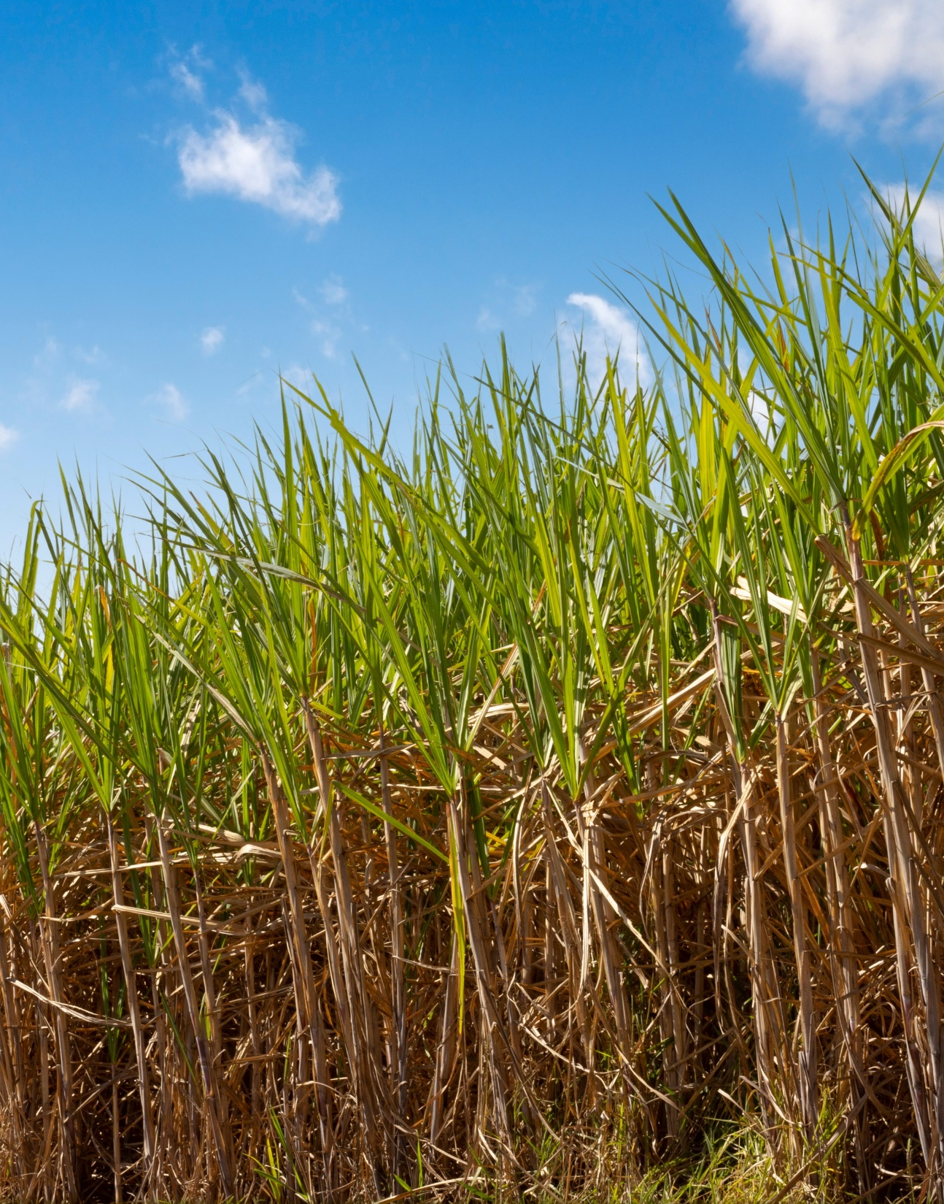
CANE

Slide 7
Action Taken Report
S. No | Discussion Point | Action Taken
1. | Single Source File Information Data from Society Level to Village Level with crop variety and soil types. | Work on integrating information and creating a single dashboard for Know you Farmer, Village and Society. Draft Dashboard Ready
2. | Transporter Performance Scorecard | Framework ready with indicators and evaluation matrix. Model to be developed.
3. | Cane loader Optimization Model | Work in Progress- Loader distribution data collected
4. | Purchi Failure | Phone calls made and information collected for 10992 purchies failed between 19thNov to 16th Dec. total growers is 8466 not supply till date.
5. | Saksham App Discussion | Saksham App training for farmers being conducted thrice a week Usage cannot be tracked as no data analytics feature in Saksham to track usage. Just the registration details can be tracked.
5. | Road Safety – Cumulative Information | Accident Snapshot -19 incidents in 8 weeks Zero causality, but women/girl/animal injuries reported 80% occurred on village roads & turns Repeating mechanical + road + electrical hazards 03 staff met with accident in the last 10 days

Slide 8
Weekly Performance Snapshot – Cane
S. No. | Capacity Utilization | Target | Current Week | Last Week | Till Date
1 | Daily Indent Rate Avg. (LQ) | As per requirement | 1.09 | 1.12 | 1.07
2 | Daily Cane Purchased Rate (LQ) | 1.00 | 1.07 | 1.06 | 1.00
3 | Gate Indent Maturity (%) | NA | 95% | 93% | 85%
4 | Center Indent Maturity (%) | NA | 100% | 96% | 94%
5 | Pol in Cane (%) | 13.80 | 13.01 | 12.92 | 11.94
6 | Middle Brix from Yard Sampling (%) | NA | 18.54 | 18.53 | 18.44
7 | Affected Cane % (from Yard Sampling) | NA | 1.1 | 1.8 | 1.90
8 | Avg. Center Cane Holding Time (Hrs.) | NA | 13.84 | 13.55 | 12.97

Slide 9
Indent, Yard Balance Vs Crushing (Lakh Qtls.) (27.12.25)

Slide 10
Cane Purchase trend till 27 Dec 2025

Slide 11
PoL Vs Recovery % (14.12.25 to 27.12.2025)

Slide 12
Historical Recovery Trend Vs Current (Last 6 years)

Slide 13
Indent Maturity (18.12.25 to 24.12.25)
Bottom 10 Centers |  |  |  |  |  |  | Top 10 Centers
S.No. | CENTRE NAME | SOCIETY NAME | INDENT (QTL) | MATURITY % | Remark |  | CENTRE NAME | SOCIETY NAME | INDENT (QTL) | MATURITY %
1 | CHAHMALPUR (ARNI) | ARNIKHANA | 495 | 42.79% | Ratoon is over for few growers, Standing ratoon ~ 2200 qtl. Survey ongoing |  | JUNGLE MATERA | AIRA | 1764 | 118.79%
2 | GATE (NANPARA) | NANPARA | 5265 | 54.56% |  |  | KATHOUTIYA | NANPARA | 3681 | 118.66%
3 | BETI SAHDEO | AIRA | 8019 | 60.28% |  |  | GATE (MAHMOODABAD) | MAHMOODABAD | 3654 | 118.47%
4 | CHAKDHA | AIRA | 1467 | 63.79% | There are sugarcane fields on both banks of the Ghaghra River, but due to the poor condition of the roads, less sugarcane is being transported. |  | GATE(LMP) | LAKHIMPUR | 6822 | 118.23%
5 | RATANGANJ II | MAHMOODABAD | 1395 | 71.63% | Ratoon is over for few growers, Standing ratoon ~ 6000 qtl Survey ongoing |  | JALLAPUR MAHSI | HARGAON | 2718 | 116.22%
6 | BEHNANPURWA | AIRA | 3339 | 71.87% |  |  | DARAPUR | HARGAON | 666 | 115.86%
7 | BELTUA | AIRA | 2925 | 73.35% |  |  | AANVA (ARNI) | ARNIKHANA | 738 | 115.81%
8 | MURI | AIRA | 1044 | 74.14% |  |  | MAHADEV /AMETHI - II | AIRA | 4482 | 115.66%
9 | AMRITPUR | NANPARA | 7677 | 74.95% | Ratoon is over for few growers, Standing ratoon ~ 8000 qtl. Survey ongoing |  | KATKUSMA | LAKHIMPUR | 4194 | 115.30%
10 | KABIRAHA | AIRA | 4959 | 75.06% |  |  | NAKAHA | LAKHIMPUR | 7974 | 115.13%
Notes:
Good: >= 90% Average: >=70% and <90% Poor: <70%

Slide 14
Average Vehicle Holding time at Purchase Center (14.12.25 to 20.12.25)
Bottom 10 Centers |  |  |  |  |  |  |  | Top 10 Centers
S. No. | CENTRE NAME | SOCIETY | Time (Hrs) | Vehicles | Loading | Remark |  | CENTRE NAME | SOCIETY | Time (Hrs) | Vehicles | Loading
1 | SEMARIA- I | AIRA | 8.03 | 118 | LOADER | The loader performs loading at this center during the second shift, but the pre-token is issued during the first shift. One loader works at 2 or 3 different centers. |  | MURI | AIRA | 0.28 | 17 | LABOUR
2 | SISAIYA -I | AIRA | 7.73 | 90 | LOADER |  |  | CHAKDHA | AIRA | 0.56 | 20 | LABOUR
3 | KATAULI | AIRA | 7.14 | 121 | LOADER |  |  | BOKARIYA | BELRAYAN | 0.75 | 64 | LOADER
4 | URRA BAZAR | NANPARA | 6.90 | 135 | LOADER |  |  | RAM NAGAR BAGAHA | BELRAYAN | 0.77 | 133 | LOADER
5 | RATANGANJ III | MAHMOODABAD | 6.88 | 43 | LABOUR | Due to Less indent |  | DANDOORI | BELRAYAN | 1.11 | 72 | LOADER
6 | LALJI PURVA | AIRA | 6.58 | 70 | LOADER | The loader performs loading at this center during the second shift, but the pre-token is issued during the first shift. One loader works at 2 or 3 different centers. |  | NAINAPUR-III | AIRA | 1.13 | 43 | LOADER
7 | AMETHI -II/PAHADIYAP | AIRA | 6.44 | 108 | LOADER |  |  | AANVA (ARNI) | ARNIKHANA | 1.2 | 45 | LOADER
8 | GOORH -I | NANPARA | 6.40 | 173 | LOADER |  |  | HARKHAPUR | NANPARA | 1.37 | 110 | LOADER
9 | GHODSARIYA | ARNIKHANA | 6.39 | 121 | LOADER |  |  | RATANGANJ II | MAHMOODABAD | 1.38 | 14 | LABOUR
10 | BETI SAHDEO | AIRA | 5.90 | 107 | LABOUR |  |  | SEMRABAZAR | BELRAYAN | 1.41 | 58 | LOADER

Slide 15
Average Truck Holding Time at Purchase Centers (14.12.25 to 20.12.25)
Bottom 10 Centers |  |  |  |  |  |  |  | Top 10 Centers
S. NO. | CENTRE | SOCIETY | HOLDING TIME (HR) | TRIPS | LOADING | Remark |  | CENTRE | SOCIETY | HOLDING TIME (HR) | TRIPS | LOADING
1 | TIKOUNA | ARNIKHANA | 11.59 | 18 | LOADER | The weighment clerk at the center recorded a weight for the trolley/bullock cart that was greater than the weight of the truck it was loaded onto. The same truck number was then recorded on the remaining trolley/bullock cart's gross weight slip, which was weighed the following day. This caused the truck with that same number to arrive late the next day. |  | LALJI PURVA | AIRA | 1.44 | 13 | LOADER
2 | AMETHI -II/PAHADIYAP | AIRA | 11.07 | 16 | LOADER |  |  | MANGAUDHIYA-III RAJ | NANPARA | 1.48 | 10 | LOADER
3 | MARSANDA -I | HARGAON | 6.89 | 20 | LABOUR |  |  | DHAURAHARA II | AIRA | 1.53 | 9 | LOADER
4 | BELWA PURWA | BELRAYAN | 6.80 | 9 | LOADER |  |  | KIRATIPURVA - III | AIRA | 1.58 | 15 | LOADER
5 | NARENDRA NAGAR BELI | BELRAYAN | 6.33 | 9 | LOADER |  |  | BOKARIYA | BELRAYAN | 1.64 | 10 | LOADER
6 | SAKETHU | LAKHIMPUR | 5.18 | 35 | LOADER |  |  | MAHADEV /AMETHI - II | AIRA | 1.64 | 18 | LOADER
7 | KHAJUHABAZAR III | AIRA | 4.90 | 13 | LOADER |  |  | TAPARPURWA | BELRAYAN | 1.66 | 16 | LOADER
8 | SHAHPUR | HARGAON | 4.88 | 18 | LOADER |  |  | SHEKHPUR | AIRA | 1.67 | 6 | LOADER
9 | SIKATIHA CHAPKAHA | AIRA | 4.34 | 15 | LOADER |  |  | HAUKANA MATERA | BELRAYAN | 1.69 | 7 | LOADER
10 | RATANGANJ II | MAHMOODABAD | 4.16 | 2 | LOADER |  |  | PACHGHARA | AIRA | 1.71 | 11 | LOADER

Slide 16
Zone wise Target V/S Cane supply 2025-26 up 27.12.2025

Slide 17
Society Wise Indent And Supply (21.12.2025 to 27.12.25)

Slide 18
Reason for failure of indent from 10.12.2025 to 16.12.2025

Slide 19
Society & village wise higher indent failure details 10.12.25 to 16.12.25

Slide 20
Reasons for indent failure details 10.12.25 to 16.12.25

Slide 21
Comparative Pol in Cane of Neighboring Sugar Factories (27.12.25)

Slide 22
Society wise new member register 2025-26
S.N. | Society Name | New member
1 | AIRA | 1942
2 | NANPARA | 342
3 | LAKHIMPUR | 206
4 | HARGAON | 190
5 | ARNIKHANA | 138
6 | BELRAYAN | 120
7 | MAHMOODABAD | 3
 | Grand Total | 2941

Slide 23
CANE LOADER PERFORMANCE (21.12.25 to 27.12.25)
Category of Issue | No. of Cases | % of Total | Remarks
Pressure Pipe Burst | 3 | 21% | Frequent issue; typically repaired within the same day or by early next morning.
Clutch Plate Broken | 3 | 21% | Significant downtime; repairs often extend into the following day.
Panja Broken | 2 | 14% | Generally resolved on the same day the issue occurs.
Pressure Pump Broken | 1 | 7% | High downtime (over 13 hours) requiring pump replacement.
Tractor Wheel Broken | 1 | 7% | Significant delay (over 16 hours) before loading resumed.
Coupling Broken | 1 | 7% | Caused the longest single delay recorded (23 hours).
Miscellaneous (Bush, Angle, Spindle) | 3 | 21% | Individual instances of structural or mechanical failures.
Total | 14 | 100%
High downtime centers
Center | Downtime
Manghaudiya 3rd & 4th | 23 hr
Khajuha bazar 1st | 16 hr 30 min
Kairatipurwa 1st | 13 hr 17 min
Sahjani | 12 hr 50 min
Nakha 3rd | 9 hr

Slide 24
Yield Assessment(Ratoon) – 01 Nov to 27 Dec
Overall Average Yield: 542.93 q/ha
Total Plots Assessed: 1319
Yield dispersion is significant, ranging from ~381 q/ha to ~687 q/ha
S.N. | Society Name | No. of plot | Avg. Yield (QTL /Hec)
1 | BELRAYAN | 17 | 631
2 | AIRA | 890 | 568
3 | NANPARA | 91 | 547
4 | MAHMOODABAD | 27 | 536
5 | HARGAON | 111 | 534
6 | ARNIKHANA | 66 | 464
7 | LAKHIMPUR | 117 | 393
 | Grand Total | 1319 | 543
Variety | No. of plot | Average of Yield (QTL /Hec)
Colk-16202 | 1 | 651
Colk-14201 | 150 | 589
co-0238 | 159 | 571
Co-0118 | 567 | 561
Cos-13235 | 50 | 553
Cos-17231 | 2 | 520
Co-15023 | 64 | 510
Cos-95255 | 1 | 500
Cos-13231 | 29 | 499
co-98014 | 87 | 490
Colk-94184 | 191 | 480
Colk-12207 | 1 | 450
Coj-85 | 7 | 449
Cos-8272 | 7 | 407
Cos-18231 | 2 | 395
UP 5125 | 1 | 358
Grand Total | 1319 | 543

Slide 25
ROAD SAFETY (21.12.25 to 27.12.25)

Slide 26
Accidents
Overall Snapshot -Transport
Total recorded accidents: 19
Fatalities: 0
Human injuries: 3 minor injuries (2 women, 1 girl)
Animal casualties/injuries:
1 goat died
1 bull injured
Primary impact: Vehicle damage, cane spillage, operational disruption
Response quality: Immediate cane lifting in almost all cases of toppling/body burst.
Cause Category | Cases
Vehicle imbalance / overturning | 6
Body burst / weak body | 3
Sharp turns / bumpy roads / potholes | 4
Overtaking / driver negligence | 3
Electrical hazards (overhead lines) | 2
Sudden animal / pedestrian movement | 3
Reasons observed
Early morning fog
Village roads with sharp turns
Repeat truck involved
Truck UP 22T 4836 appears twice, Transporter- Madhav Mishra
Three Cane Department ACDOs met with accident in Khamariya due to fog, dog attack and brake failure of the motor bike. No fracture or major injury.

Slide 27
KOLHU AND CRUSHERS
Particulars | Total (No’s) | Rate/ Qtl. (Rs.) | Running (No’s) |  | Crushing (Qtls.) |  | Recovery (%)
 |  |  | This week | To Date (27.12.25) | This week | To Date (27.12.25)
Kolhu | 192 | 380-440 | 0 | 189 | 189000 | 1265985 | 12.40%
Crushers | 15 | 370-390 | 0 | 14 | 882000 | 3491000 | NA
 | Total: |  |  |  | 1071000 | 4756985

Slide 28
Call Center Update (21.12.25 to 27.12.25)
Banners at all 106 centres displayed
Category | No. of Cases | % of Total | Remarks
Logistics (Truck Availability) | 1 | 25% | Resolved via Zonal Manager; expected after 2 PM.
Financial (Payment Query) | 1 | 25% | Timeline provided; payment due in 2-3 days.
Administrative / Others (Pd Notes) | 2 | 50% | Includes Sisaiya-II and Sakethu centers.
Total | 4 | 100% | All cases marked as Resolved.

Slide 29
Progress report of Saksham App installation as per Zonal Incharge till 27.12.2025
Date | Saksham App enrollment status
 | On date | To date
21/12/2025 | 68 | 39088
22/12/2025 | 50 | 39138
23/12/2025 | 40 | 39178
24/12/2025 | 75 | 39253
25/12/2025 | 70 | 39323
26/12/2025 | 75 | 39398
27/12/2025 | 35 | 39433

Slide 30
Comparative Payment Figures of Neighboring Mills (As on 27.12.2025)
Name of Factory | Date of Start | Payment Up to
Aira | 26.10.2025 | 14.12.2025
Ajbapur | 27.10.2025 | 12.12.2025
Kumbhi | 31.10.2025 | 16.12.2025
Gularia | 31.10.2025 | 16.12.2025
Belrayan | 12.11.2025 | 12.12.2025
Gola | 05.11.2025 | 10.02.2025
Pallia | 07.11.2025 | 15.02.2025
Khambharkhera | 05.11.2025 | 20.02.2025

Slide 31
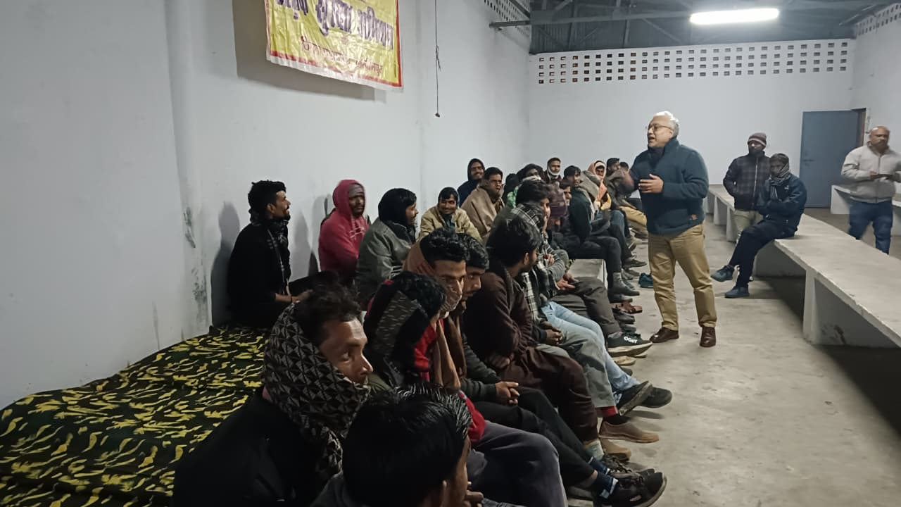
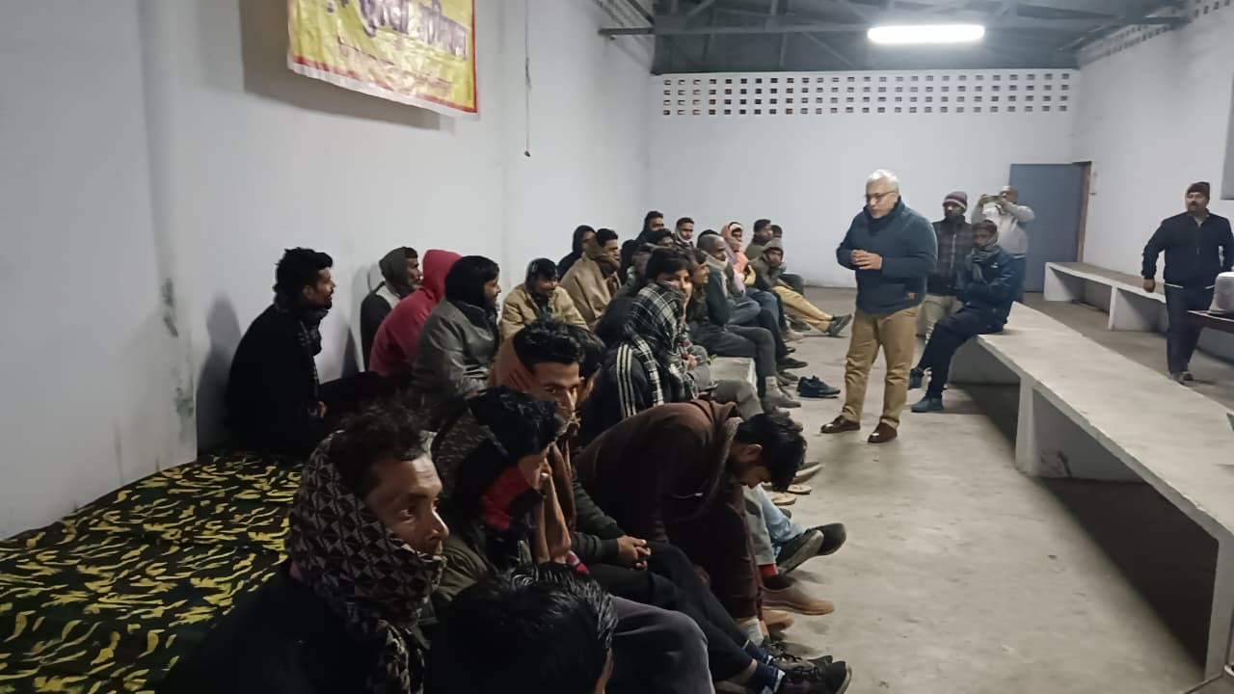
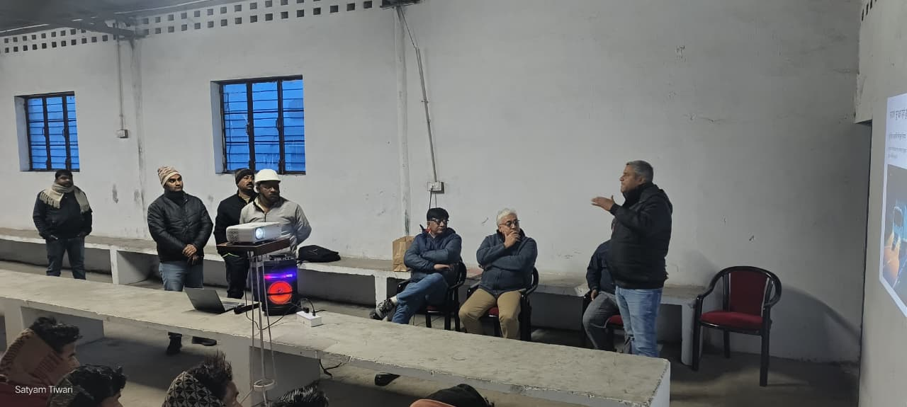
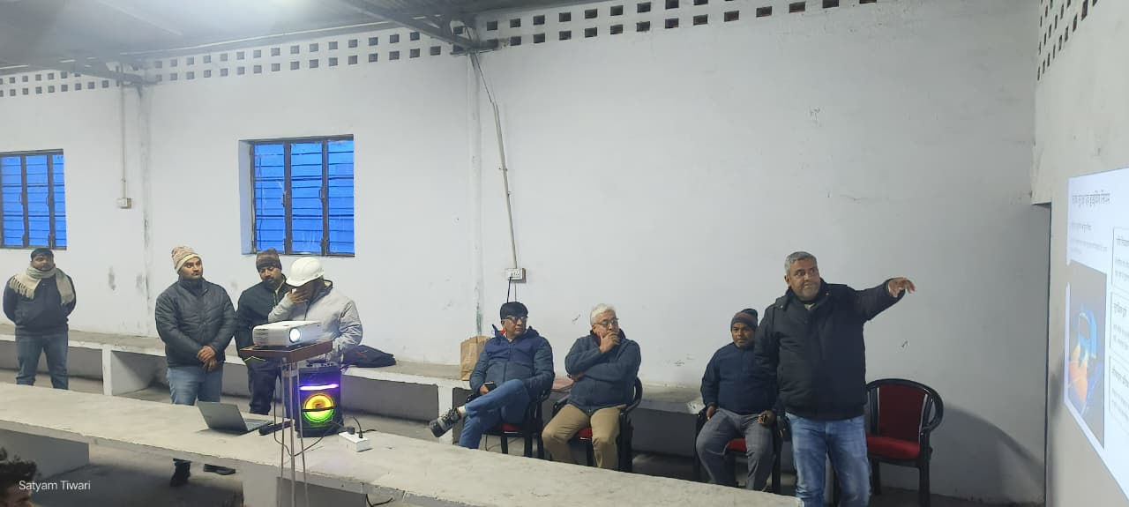
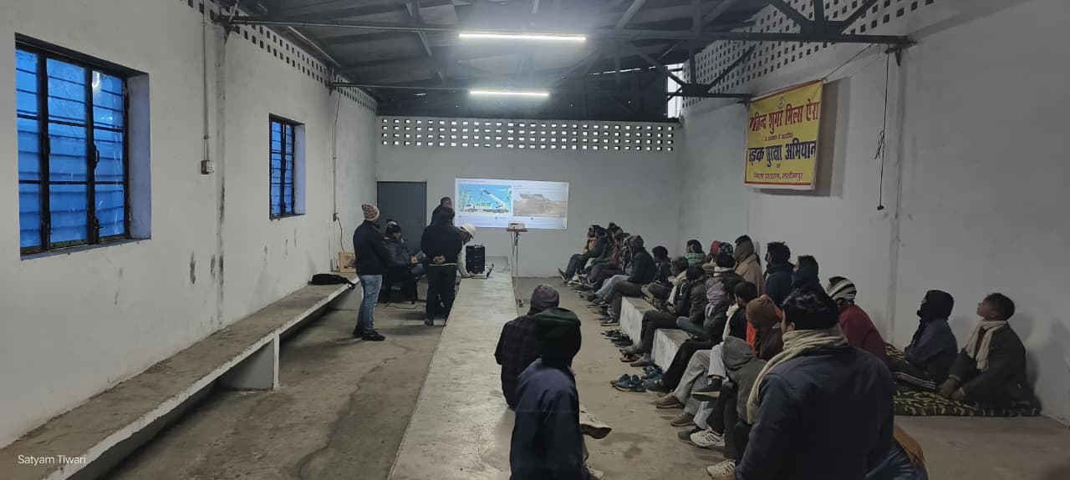
Truck drivers and growers are being given daily safety training for safe driving.

Slide 32
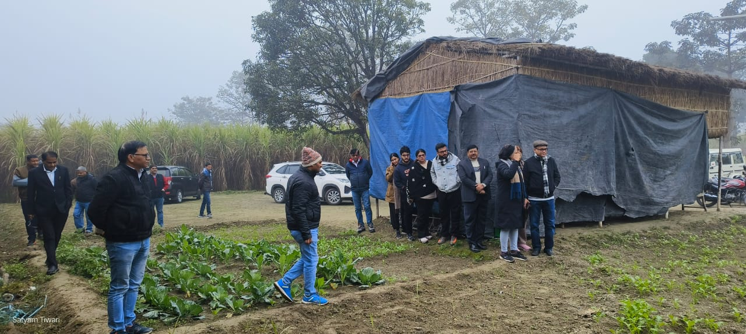
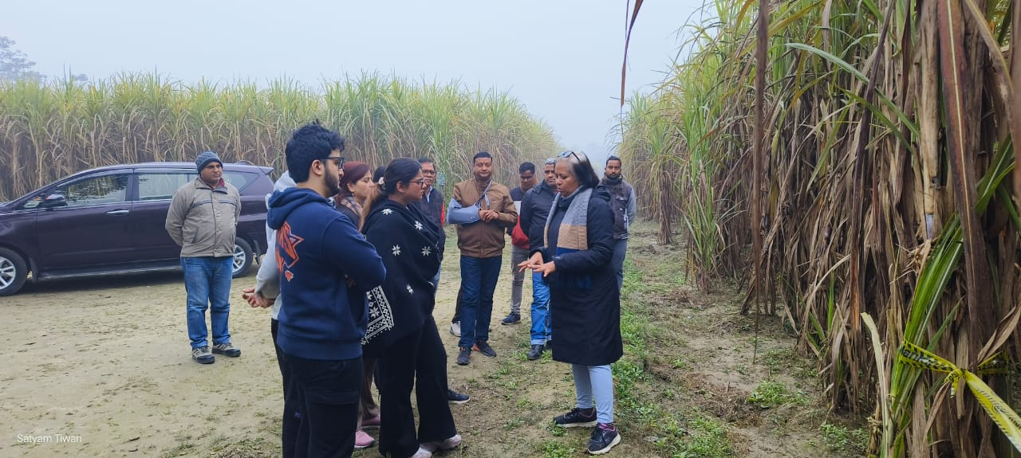
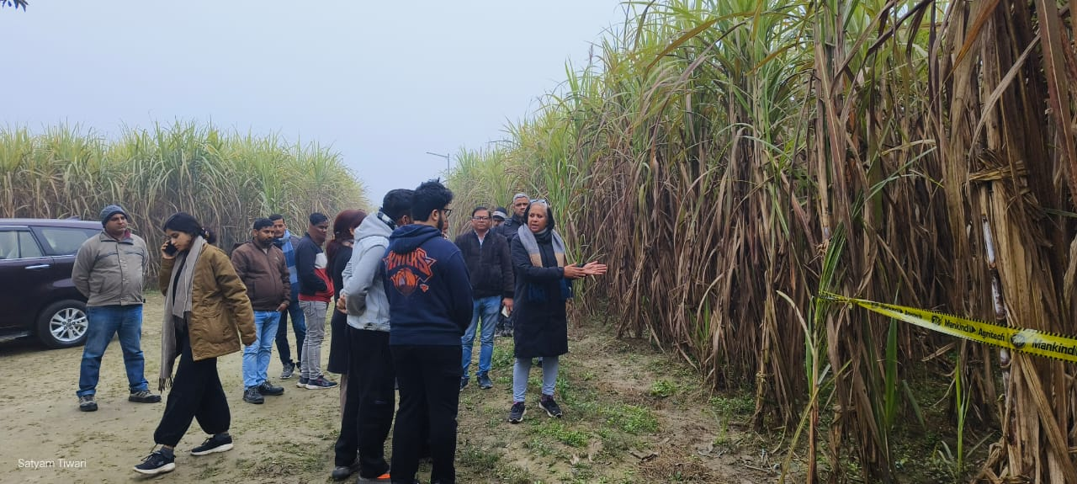
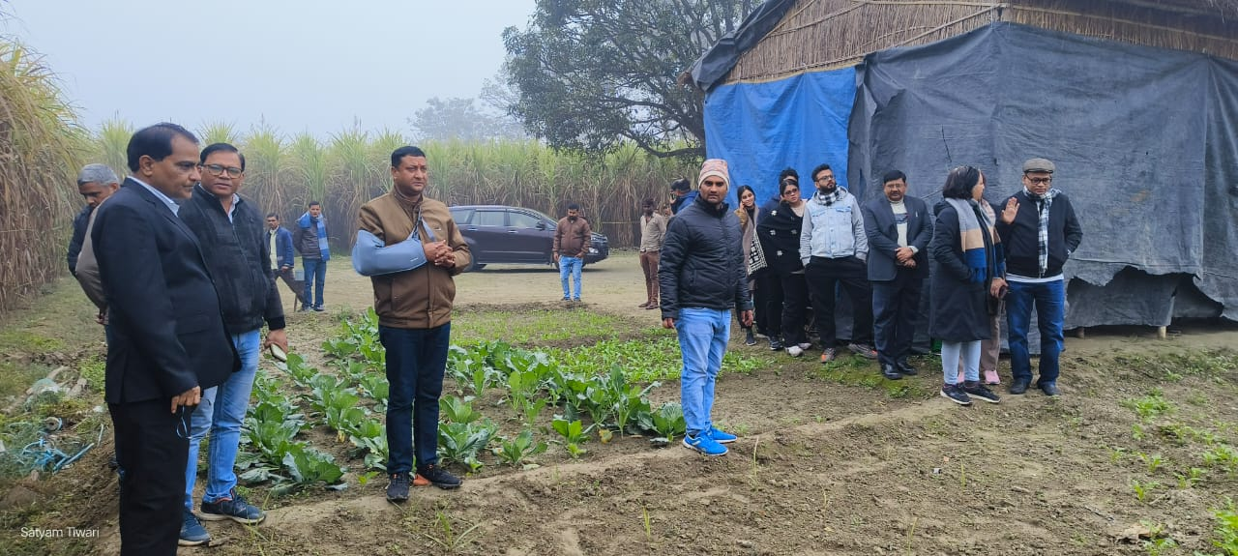
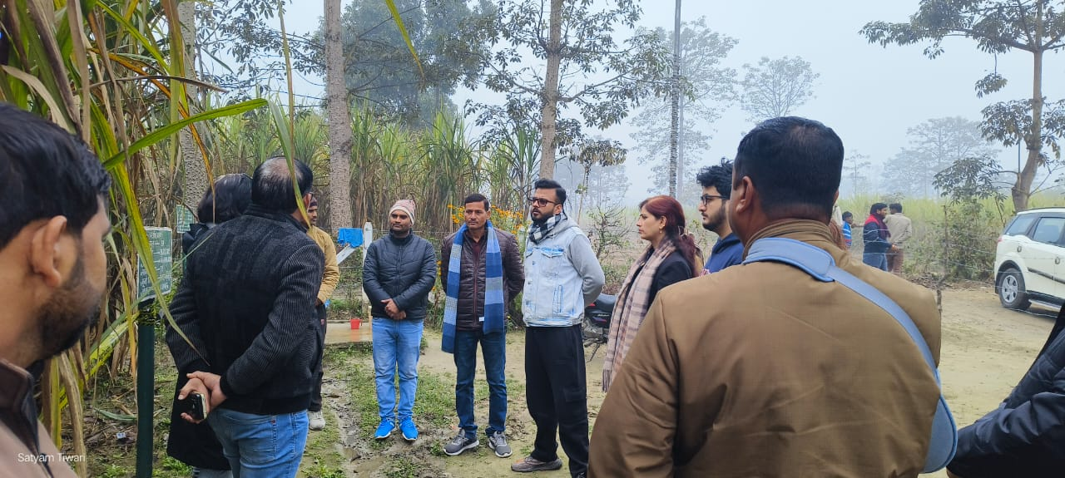
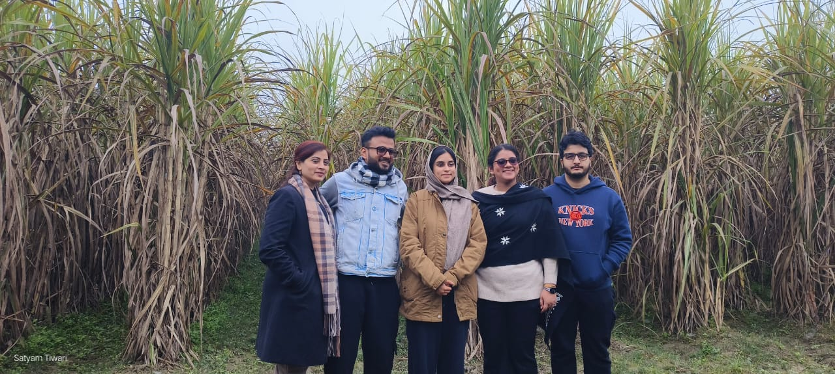
R&D farm was visited by the Resp. M.D. Sir along with his family.

Slide 33
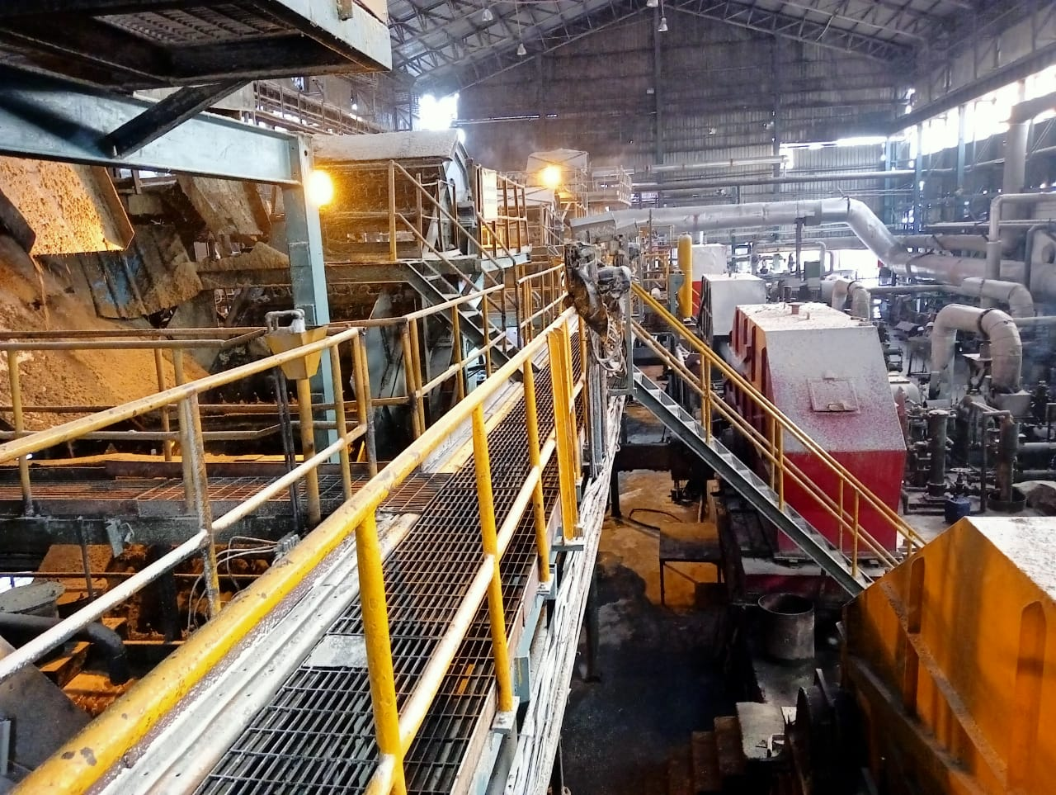
ENGINEERING

Slide 34
General Observations of the Week
Last Week Crush: 7.51 Lakhs Qtls. @ 1.073 Lakhs/Day (Ever highest in a week)
(Previous Highest Crush of week: 7.435 @ 1.062 average/day)
Highest Crush in a shift: 38129 Qtls on dated 27.12.25 (8/4 shift)
(last highest was 37827 dated 24.12.25,12/8 shift)
Highest Crush in a day on dated 24.12.25: 1.10 Lakhs Qtls.
Other Highest Crush in season 25-26: 1.08 (23.11), 1.085 (29.11), 1.091 (02.12), 1.07 (13.12), 1.075 (16.12), 1.075 ( 22.12),
1.07 (23.12), 1.07 (25.12), 1.075 (27.12)
Last year Highest Crush was 1.09
Ever Highest Crush with one edge of shredder tip: 26.23 L Qtls up to 27.12 & it will plan to do up to 01.01.26. After Crush of 25 L, PI is 90 on dated 26.12
Last year Highest was 25.25 L Qtls.
Average To date Crush on 61st crop day is 1 L Qtls. including stoppage & 1.017 excluding stoppage
Particulars | Weekly |  | Till Date
 | SN. 25-26 | SN. 24-25 | SN. 25-26 | SN. 24-25
Hours Worked | 167.28 | 165.48 | 1489.35 | 1488.21
Hours Available | 168.00 | 168.00 | 1512.00 | 1512.00
Hours Utilized (%) | 99.68 | 98.69 | 98.52 | 98.44

Slide 35
Key Operational Parameter- Current Season Vs Last Season
Particulars | Weekly |  | To date
 | SN 25-26 | SN 24-25 | SN 25-26 | SN 24-25
Cane Crushed (In Qtls.) | 751000 | 708100 | 6314200 | 5782200
Rate of Crush | 107286 | 101157 | 100225 | 91781.0
Pol % Bagasse | 1.71 | 1.74 | 1.75 | 1.77
Loss in Bagasse % Cane | 0.49 | 0.46 | 0.49 | 0.49
Moisture % Bagasse | 50.07 | 49.73 | 50.14 | 50.24
Total Power kw/ Ton of cane | 32.20 | 32.52 | 32.03 | 32.91
Total Power MWH (Sugar) | 11.88 | 11.14 | 10.95 | 9.99
Lubricant Consumption. | 0.04 | 0.04 | 0.04 | 0.04

Slide 36
Weekly Performance Snapshot - Engineering
S.No. | Capacity Utilization | Target 2025-26 | Current Week. 21.12.25 to 27.12.25) | Last Week | Till Date (27.12.25)
1 | Cane Crushed (LQ) (192 Days) | 179.00 | 7.51 | 7.435 | 63.14
2 | Hours Utilized (%) | 99.17 | 99.68 | 99.53 | 98.52
3 | Downtime (Hrs.) | 72.00 | 0.32 | 0.47 | 15.09
4 | Planned Stoppage (Hrs.) | 48.00 | 0.00 | 0.21 | 10.08
5 | Forced Shutdown (Hrs.) | 24.00 | 0.32 | 0.26 | 9.21
6 | Capacity Utilization in Uptime @ 1 LQ / Day Base (%) | 94.71 | 107.63 | 106.71 | 101.73
7 | Capacity Utilization incl. Stoppage (%) | 93.22 | 107.29 | 106.21 | 100.23
 | Quality
1 | Pol % Bagasse | 1.65 - 1.70 | 1.71 | 1.71 | 1.75
2 | Moisture % Bagasse | 49 - 49.5 | 50.14 | 50.06 | 50.14
 | Consumption
1 | Steam Consumption (KG/Qtl Cane) | 5.0-6.0 | 4.78 | 4.85 | 4.90
2 | Power Consumption (KW/T Cane) | 31.5 - 32 | 32.20 | 31.97 | 32.03
3 | Lubricant Consumption (Kg/100 Qtl Cane) | 0.04 | 0.04 | 0.04 | 0.04
36

Slide 37
Monthly figure
Plant Performance in Season 25-26
Sr No | Particulars | Unit | Season 25-26
 |  |  | Target | Achieved (27.12.25 )
1 | Total Cane Crushed | Qtls | 17900000 | 6314200
2 | Date of Start | Date | 20/10/2025 | 26/10/2025
3 | Date of Finish | Date | 23/04/2026 | -
4 | Gross Season Days | Nos | 192 | 63
5 | Crushing rate Including Stoppage | Qtls | 93229 | 100225
6 | Crushing rate Excluding stoppage | Qtls | 94709 | 101733
7 | Capacity Utilization | % | 94.71 | 101.73
8 | Total Stoppage Hours | Hrs. | 72.00 | 22.25
9 | Planned Shutdown | Hrs. | 48.00 | 10.08
10 | Forced Shutdown | Hrs. | 24:00 | 9.21
11 | Preparatory index | % | 90.0-91.0 | 90.58
12 | Primary Extraction | % | 70.5-71.0 | 71.34
13 | Mill Extraction ( ME) | % | 96 - 96.5 | 95.90
14 | Reduced mill Extraction (RME) | % | 96.4 - 96.80 | 96.15
15 | Bagasse % Cane | % | 29.00 | 27.88
16 | Pol % Bagasse | % | 1.65-1.70 | 1.75
17 | Moisture % Bagasse | % | 49.0 - 49.5 | 50.14
18 | Imbibition % Cane | % | 40 Max | 36.57
19 | Imbibition % Fibre | % | 290 - 295 | 276.80
20 | Dry Milling Factor | % | 71.25 | 71.70
21 | Grease & Lubricants Kg/100 Qtls Cane | % | 0.04 | 0.04
22 | Power Consumption ( KW/T Cane) | % | 31.5 - 32 | 32.03
23 | Steam Consumption Sugar (Kg/Q of Cane) | % | 5.0-6.0 | 4.90
37

Slide 38
Stoppages, Actions & RCA for the Week
Stoppage Details Crushing Season 2025-26
S NO | Report Date | Head | Section | Equipment Name | Type | From | To | Stoppage Duration in Hrs | Stoppages Reason
87 | 21/12/2025 | Mechanical | Cane Handling | Cane Carrier | Tripped | 21/12/2025 23:53 | 21/12/2025 23:55 | 0:02 | Main Cane Carrier motor stalled due to overload
88 | 23/12/2025 | Mechanical | Cane Handling | Cane Carrier | Tripped | 24/12/2025 06:36 | 24/12/2025 06:42 | 0:06 | Main Cane Carrier motor stalled due to overload
89 | 24/12/2025 | Mechanical | Cane Preparation | Feeder Drum | Tripped | 24/12/2025 10:09 | 24/12/2025 10:11 | 0:02 | Feeder Drum Tripped Due to high load
90 | 25/12/2025 | Mechanical | SRC & IRC | IRC No-1 | Tripped | 25/12/2025 13:19 | 25/12/2025 13:32 | 0:13 | IRC No-1 Tripped due to Overload
91 | 26/12/2025 | Mechanical | Cane Preparation | Feeder Drum | Tripped | 26/12/2025 08:25 | 26/12/2025 08:30 | 0:05 | Cane Carrier & Feeder Drum Tripped due to overload
92 | 27/12/2025 | Mechanical | Cane Preparation | Feeder Drum | Tripped | 27/12/2025 14:02 | 27/12/2025 14:04 | 0:02 | Feeder Drum & Cane Carrier Tripped due to overload
93 | 27/12/2025 | Mechanical | Cane Handling | Cane Carrier | Tripped | 27/12/2025 22:35 | 27/12/2025 22:37 | 0:02 | Main Cane Carrier motor stalled due to overload
Totals |  |  |  |  |  |  |  | 032
Note: To control the overloading on feeder drum, a hooter with light provided at kicker on dated 18.12.25, positive result seen but still its under observation

Slide 39
Stoppages Till 20.12.2025 CONPARETIVE SUMMARY - INCIDENCE REPORT OF MILL STOPPAGE
S.NO | PARTICULAR | SEASON 2019-20 | SEASON 2020-21 | SEASON 2021-22 | SEASON 2022-23 | SEASON 2023-24 | SEASON 2024-25 | SEASON 2025-26
A | MECHANICAL STOPPAGE DETAILS
1 | CANE UNLOADER | 00:00:00 | 00:45:00 | 00:13:00 | 00:15:00 | 00:00:00 | 00:00:00 | 00:00:00
2 | CANE CARRIER | 68:17:00 | 01:51:00 | 08:48:00 | 07:19:00 | 00:18:00 | 01:56:00 | 00:16:00
3 | CANE JAMMING NEAR CANE KICKER | 01:01:00 | 00:52:00 | 00:00:00 | 00:19:00 | 00:00:00 | 00:28:00 | 00:00:00
4 | FEEDER DRUM TRIPPED | 02:40:00 | 02:07:00 | 00:08:00 | 00:00:00 | 00:17:00 | 01:46:00 | 02:02:00
5 | SHREDDER | 01:39:00 | 07:31:00 | 00:40:00 | 38:46:00 | 105:00:00 | 02:29:00 | 02:20:00
6 | SHREDDER KICKER | 03:28:00 | 00:00:00 | 00:00:00 | 00:00:00 | 00:00:00 | 00:00:00 | 00:00:00
7 | CANE BELT CONVEYOR | 00:12:00 | 01:10:00 | 00:00:00 | 00:00:00 | 12:48:00 | 00:12:00 | 00:00:00
8 | RAKE CARRIER & INTER CARRIER | 26:35:00 | 05:00:00 | 17:43:00 | 09:30:00 | 09:08:00 | 03:13:00 | 04:03:00
9 | MILLS | 04:30:00 | 20:56:00 | 08:01:00 | 02:00:00 | 03:54:00 | 00:34:00 | 00:21:00
10 | DONALLY CHUTE | 00:00:00 | 10:26:00 | 06:29:00 | 02:22:00 | 00:50:00 | 01:58:00 | 00:00:00
11 | JUICE TRAY JAMMING | 00:00:00 | 01:38:00 | 00:00:00 | 00:00:00 | 00:00:00 | 00:00:00 | 00:00:00
12 | TURBINE | 03:28:00 | 00:50:00 | 01:29:00 | 00:00:00 | 00:24:00 | 00:00:00 | 00:29:00
13 | BOILING HOUSE | 03:57:00 | 00:00:00 | 05:21:00 | 00:49:00 | 01:15:00 | 00:00:00 | 00:00:00
14 | TOTAL MACHENICAL (MILL & BH) | 115:47:00 | 53:06:00 | 48:52:00 | 61:20:00 | 133:54:00 | 12:36:00 | 9:31:00
B | TOTAL STOPPAGE DETAILS
1 | NO CANE | 162:44:00 | 101:22:00 | 63:23:00 | 43:36:00 | 42:40:00 | 32:55:00 | 0:00:00
2 | WEATHER | 00:00:00 | 00:00:00 | 20:39:00 | 00:00:00 | 00:00:00 | 0:00:00 | 0:00:00
3 | CRUSH REDUCE | 00:00:00 | 01:51:00 | 02:43:00 | 04:05:00 | 15:55:00 | 0:00:00 | 0:00:00
4 | MECHANICAL | 115:47:00 | 53:10:00 | 48:52:00 | 61:20:00 | 135:54:00 | 12:36:00 | 8:59:00
5 | PROCESS | 00:40:00 | 00:24:00 | 02:00:00 | 00:00:00 | 00:00:00 | 0:00:00 | 0:00:00
6 | GENERAL CLEANING | 41:31:00 | 45:05:00 | 54:09:00 | 97:53:00 | 58:04:00 | 35:15:00 | 4:20:00
7 | GROWER STRIKE | 56:48:00 | 12:00:00 | 00:00:00 | 00:00:00 | 00:00:00 | 0:00:00 | 0:00:00
8 | MISE | 20:39:00 | 00:55:00 | 02:40:00 | 00:45:00 | 02:41:00 | 4:37:00 | 6:04:00
9 | ELECTRICAL | 05:29:00 | 04:45:00 | 03:00:00 | 11:33:00 | 02:13:00 | 9:12:00 | 0:20:00
10 | BOILER | 23:00:00 | 11:59:00 | 06:23:00 | 29:48:00 | 00:26:00 | 2:53:00 | 2:10:00
11 | INSTRUMENT | 00:56:00 | 00:30:00 | 00:00:00 | 00:12:00 | 02:04:00 | 0:18:00 | 0:00:00
12 | TOTAL STOPPAGE | 427:34:00 | 232:01:00 | 203:49:00 | 249:12:00 | 259:57:00 | 97:46:00 | 21:53:00

Slide 40
Monthly Comparative Data (Season 2023-24 to 2025-26)
Sr No | Particulars | Unit | Season 2025-26 | Season 2024-25 | Season 2025-26 | Season 2024-25
 |  |  | November | November | December up to 27.12.25 | December
1 | Total Cane Crushed | Qtls | 3055700 | 2777600 | 2833100 | 3062400
2 | Gross Season Days | Nos | 30 | 30 | 27 | 31
3 | Crushing rate Including Stoppage | Qtls | 101857 | 92587 | 104930 | 98787
4 | Crushing rate Excluding stoppage | Qtls | 103620 | 93877 | 106286 | 100877
5 | Total Hrs Available | Hrs | 720:00 | 720 | 648:00 | 744:00:00
6 | Days Worked | Nos | 29.49 | 29.59 | 26.66 | 30.36
7 | Hrs Worked | Hrs | 707:45 | 710.10 | 639:44 | 728:35:00
8 | Capacity Utilization | % | 98.30 | 98.63 | 98.72 | 97.93
9 | Total Stoppage Hours | Hrs. | 12:15 | 9.50 | 8:16:00 | 15:25
10 | Above 100000 Qtls Cane Crushing | Days | 25 | 19 | 26 | 22
11 | Highest Cane Crushing in Days | Qtls | 108500 | 102000 | 110000 | 104000
12 | Mill Extraction ( ME) | % | 95.61 | 95.38 | 96.25 | 96.31
13 | Reduced mill Extraction (RME) | % | 71.74 | 95.77 | 71.65 | 96.46
14 | Bagasse % Cane | % | 27.83 | 28.12 | 27.90 | 27.04
15 | Pol % Bagasse | % | 1.76 | 1.80 | 1.71 | 1.72
16 | Moisture % Bagasse | % | 50.18 | 50.34 | 50.06 | 49.73
17 | Imbibition % Cane | % | 35.63 | 37.05 | 38.07 | 38.24
18 | Imbibition % Fibre | % | 270.47 | 268.78 | 286.83 | 295.45
19 | Dry Milling Factor | % | 71.74 | 71.44 | 71.65 | 72.52
20 | Grease & Lubricants Kg/100 Qtls Cane | % | 0.04 | 0.04 | 0.06 | 0.04
21 | Power Consumption ( KW/T Cane) | % | 32.21 | 33.07 | 31.85 | 32.71

Slide 41
Sugar Power Consumption Breakup ( MWH) Week 21.12.2025 to 27.12.2025
Comparative data for Cane Crushed , Power Generation , Export and SPE Division Power Consumption of Year 24-25 Vs 25-26
Date | Cane Crushed (MT) |  | Sugar Power Consumption Breakup
 |  |  | SHREDDER-1&2 (MW/Hrs.) |  | Zero & 4th Mill (MW/Hrs.) |  | DS House (MW/Hrs.) |  | Raw & Ref. House (MW/Hrs.) |  | Total Power Consumption-Sugar
 | 24-25 | 25-26 | 24-25 | 25-26 | 24-25 | 25-26 | 24-25 | 25-26 | 24-25 | 25-26 | 24-25 | 25-26
21-Dec | 101100 | 106500 | 3.32 | 3.94 | 0.85 | 1.13 | 2.38 | 2.11 | 2.35 | 2.16 | 11.05 | 11.63
22-Dec | 101700 | 107500 | 3.51 | 4.04 | 0.87 | 0.94 | 2.28 | 2.24 | 2.28 | 2.25 | 11.03 | 11.76
23-Dec | 101500 | 107000 | 3.49 | 4.02 | 0.87 | 0.92 | 2.34 | 2.17 | 2.25 | 2.25 | 11.07 | 11.75
24-Dec | 103200 | 110000 | 3.65 | 4.14 | 0.86 | 0.93 | 2.19 | 2.23 | 2.30 | 2.24 | 11.25 | 11.94
25-Dec | 93800 | 107000 | 3.46 | 4.11 | 0.81 | 0.94 | 2.23 | 2.28 | 2.11 | 2.33 | 10.71 | 12.02
26-Dec | 102200 | 105500 | 3.70 | 4.14 | 0.86 | 0.93 | 2.23 | 2.28 | 2.22 | 2.34 | 11.28 | 12.07
27-Dec | 103400 | 107500 | 3.75 | 4.11 | 0.87 | 0.93 | 2.23 | 2.26 | 2.30 | 2.33 | 11.37 | 12.01

Slide 42
Milling Data (21.12.2025 to 27.12.2025)
Crop Day | Date | Cane Crush in Qlts |  | Av Crush Rate Excl Stopp |  | Imbibition % Fiber |  | Maceration % Cane |  | Bag Pol |  | Bag Moisture |  | Power kw / T Cane |  | Stoppage
 |  | On date | To date | On Day | To date | On date | To date | On date | To date | On date | To date | On date | To date | On date | To date | To date | Remarks
 | Target | 93229 | 17900000 |  |  | 290-295 |  | 40% Max |  | 1.65-1.70 |  | 49.00-49.5 |  | 31.50-32.00 |  | 72
57 | 21/12/2025 | 106500 | 5669700 | 106648 | 101088 | 283.64 | 275.80 | 38.18 | 36.38 | 1.72 | 1.76 | 50.12 | 50.15 | 31.92 | 32.00 | 22:25 | Main Cane Carrier motor stalled due to overload
58 | 22/12/2025 | 107500 | 5777200 | 107500 | 101201 | 284.28 | 275.93 | 38.07 | 36.41 | 1.71 | 1.76 | 50.07 | 50.15 | 31.83 | 32.00
59 | 23/12/2025 | 107000 | 5884200 | 107447 | 101307 | 285.30 | 276.12 | 37.95 | 36.44 | 1.71 | 1.76 | 50.15 | 50.15 | 31.95 | 32.00 |  | Main Cane Carrier motor stalled due to overload
60 | 24/12/2025 | 110000 | 5994200 | 110152 | 101457 | 285.18 | 276.31 | 37.98 | 34.47 | 1.72 | 1.76 | 50.10 | 50.15 | 31.48 | 31.99 |  | Feeder drum trip due to Overload
60 | 24/12/2025 | 110000 | 5994200 | 110152 | 101457 | 285.18 | 276.31 | 37.98 | 34.47 | 1.72 | 1.76 | 50.10 | 50.15 | 31.48 | 31.99
61 | 25/12/2025 | 107000 | 6101200 | 107976 | 101564 | 282.85 | 276.40 | 37.92 | 36.49 | 1.71 | 1.76 | 49.98 | 50.14 | 32.61 | 32.00 |  | IRC No-1 Tripped due to overload
62 | 26/12/2025 | 105500 | 6206700 | 105868 | 101634 | 288.65 | 276.68 | 38.82 | 36.53 | 1.70 | 1.76 | 50.12 | 50.14 | 33.21 | 32.02 |  | Feeder Drum & Cane Carrier Tripped due to overload
63 | 27/12/2025 | 107500 | 6314200 | 107799 | 101733 | 287.86 | 276.80 | 38.70 | 36.57 | 1.70 | 1.75 | 49.98 | 50.14 | 32.40 | 32.03 |  | Feeder Drum & Cane Carrier Tripped due to overload (2Times)

Slide 43
Vibration & Motor Power Data for Shredder Rotor (21.12.2025 to 27.12.2025)
Crop Day | Date | Crush |  | Shredder Vibration & Bearing Temp ( LHS ) -1 |  |  |  |  | Shredder Vibration & Bearing Temp (RHS)-2
 |  | On date | To date | Motor LHS Power | Brg Temp (Avg) | V (Avg) | H (Avg) | A (Avg) | Motor RHS Power | Brg Temp (Avg) | V (Avg) | H (Avg) | A (Avg)
57 | 21/12/2025 | 106500 | 5669700 | 108.29 | 57.83 | 1.63 | 1.57 | 3.28 | 107.88 | 55.37 | 1.62 | 1.40 | 3.24
58 | 22/12/2025 | 107500 | 5777200 | 109.60 | 58.40 | 1.66 | 1.58 | 3.26 | 109.06 | 56.02 | 1.61 | 1.35 | 2.92
59 | 23/12/2025 | 107000 | 5884200 | 110.96 | 57.95 | 1.53 | 1.54 | 3.07 | 109.75 | 55.19 | 1.57 | 1.30 | 2.97
60 | 24/12/2025 | 110000 | 5994200 | 113.10 | 58.72 | 1.87 | 1.63 | 3.73 | 112.45 | 55.99 | 1.64 | 1.41 | 2.87
61 | 25/12/2025 | 107000 | 6101200 | 112.95 | 58.48 | 1.60 | 1.60 | 3.13 | 111.94 | 55.85 | 1.60 | 1.43 | 2.86
62 | 26/12/2025 | 105500 | 6206700 | 113.01 | 58.65 | 1.54 | 1.54 | 2.80 | 111.94 | 55.08 | 1.52 | 1.33 | 2.58
63 | 27/12/2025 | 107500 | 6314200 | 113.61 | 58.99 | 1.50 | 1.56 | 2.72 | 112.35 | 55.08 | 1.57 | 1.39 | 2.54

Slide 44
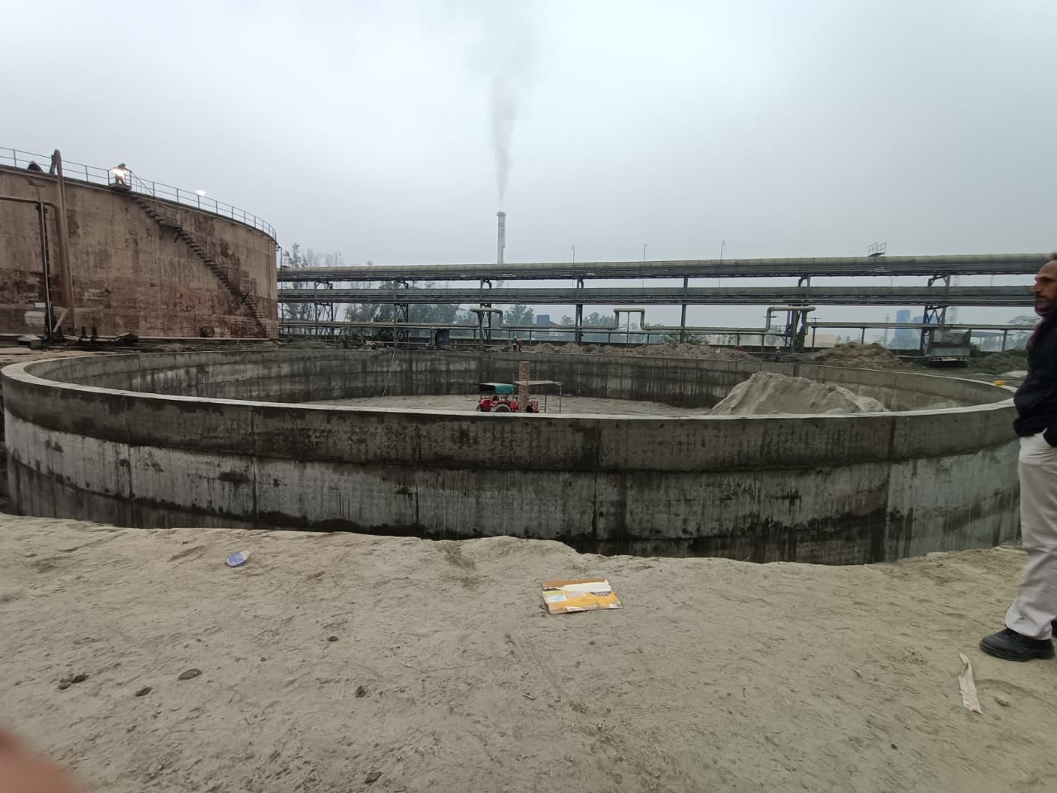
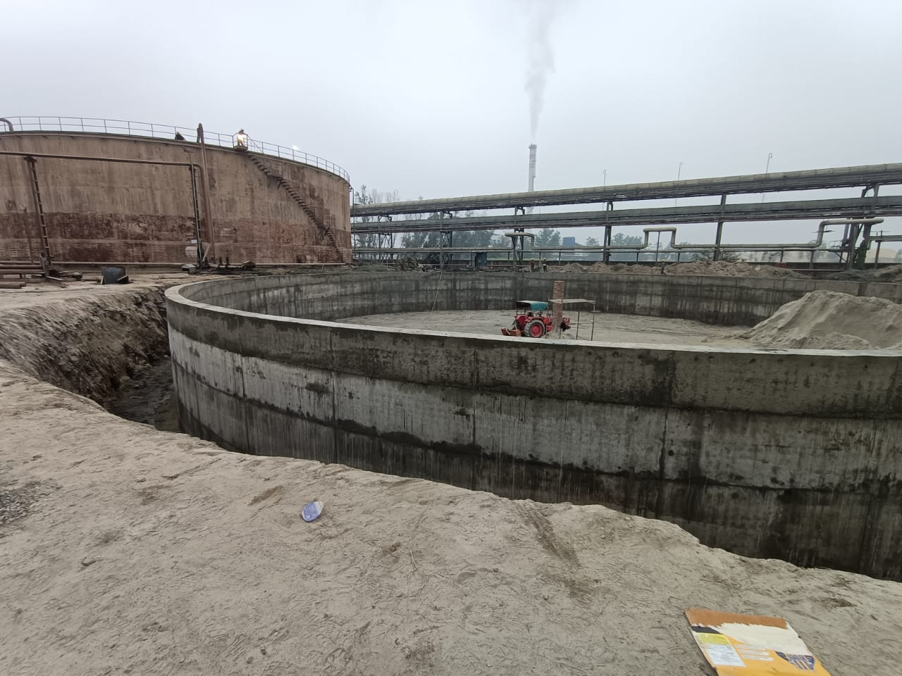
Outer Ring wall casting done & Inside Sand filling to be started
Capex Under Progress
New Molasses Tank Foundation

Slide 45
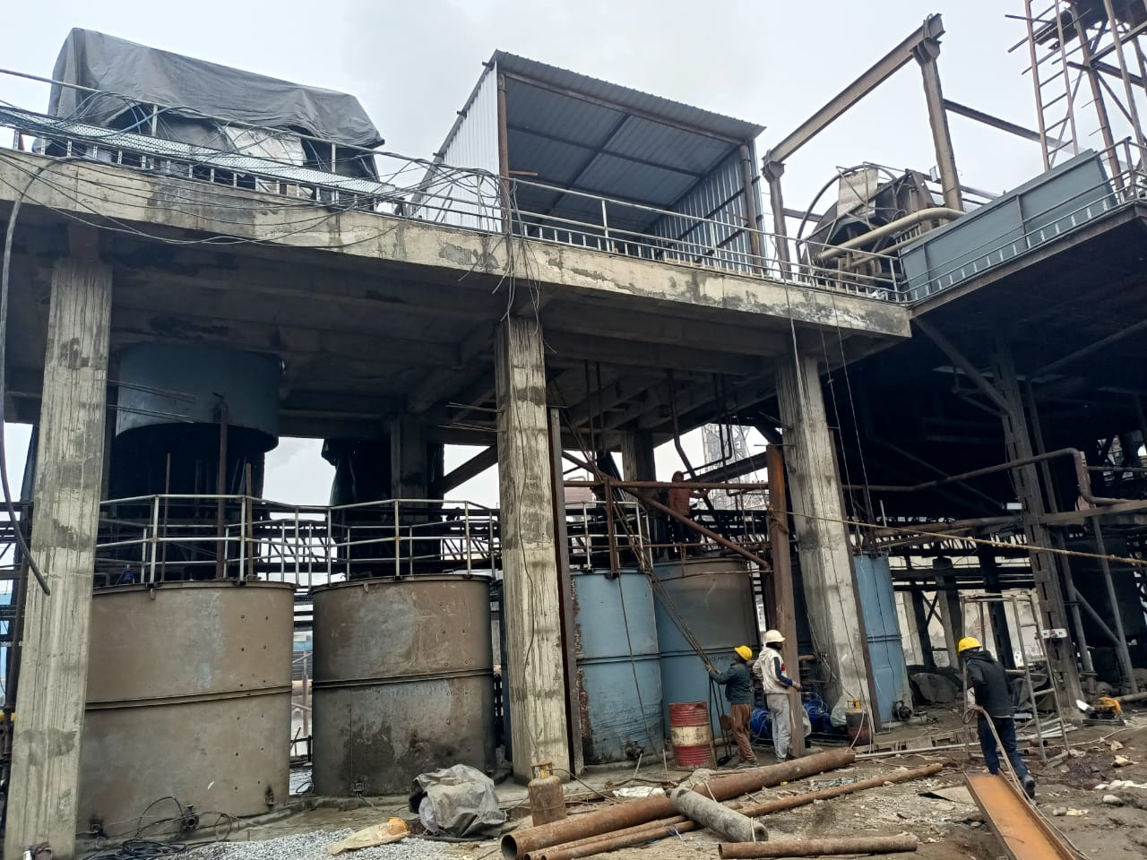
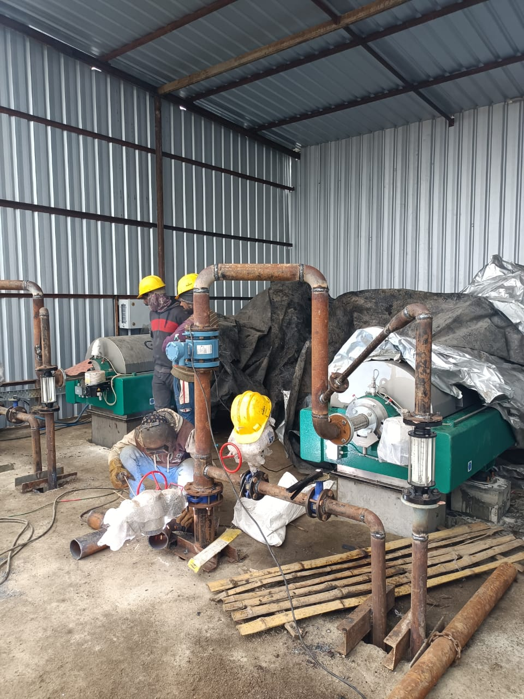
Mud Removal System –Decanter
Both Decanter, Tanks with piping Erection completed.
Panel Placed at position electrical & Instrument wire work under progress.
GEA & Chemical system may be reached at site by 30.12 to start commissioning

Slide 46
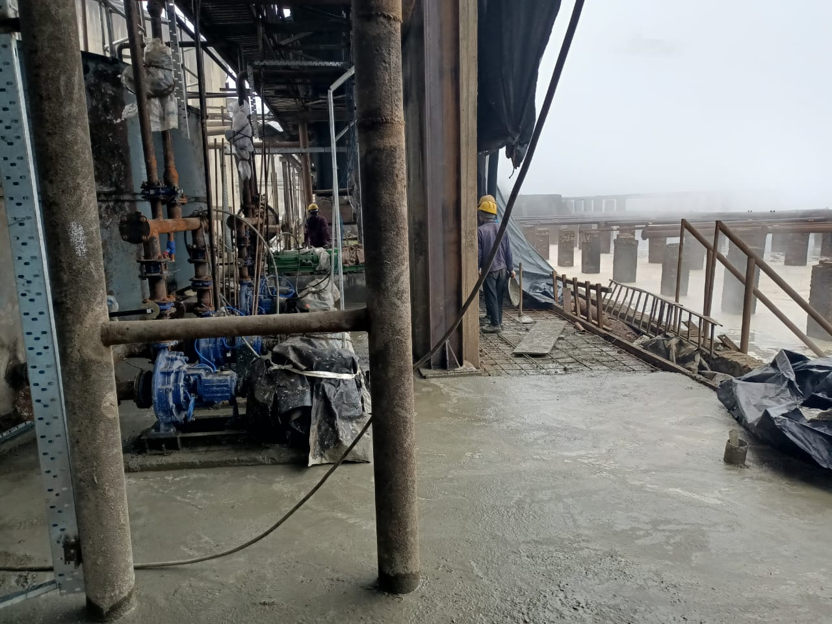
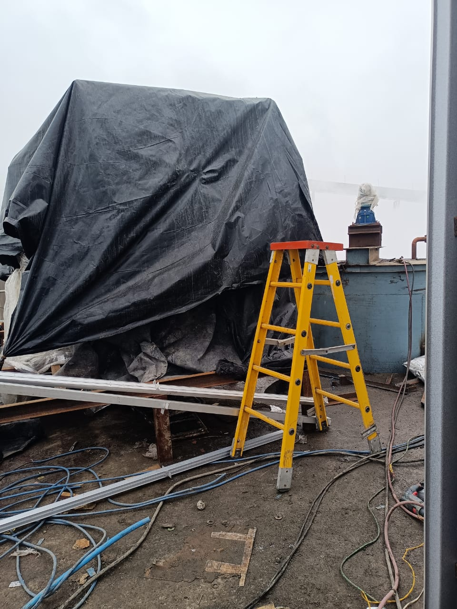
Mud Removal System –Decanter
All tanks placed at position & Pipeline work Completed .
All pumps Fitted at Position, Coupling & Pipeline fitting Completed.
Electrical & Instrument Cabling work Under progress.

Slide 47
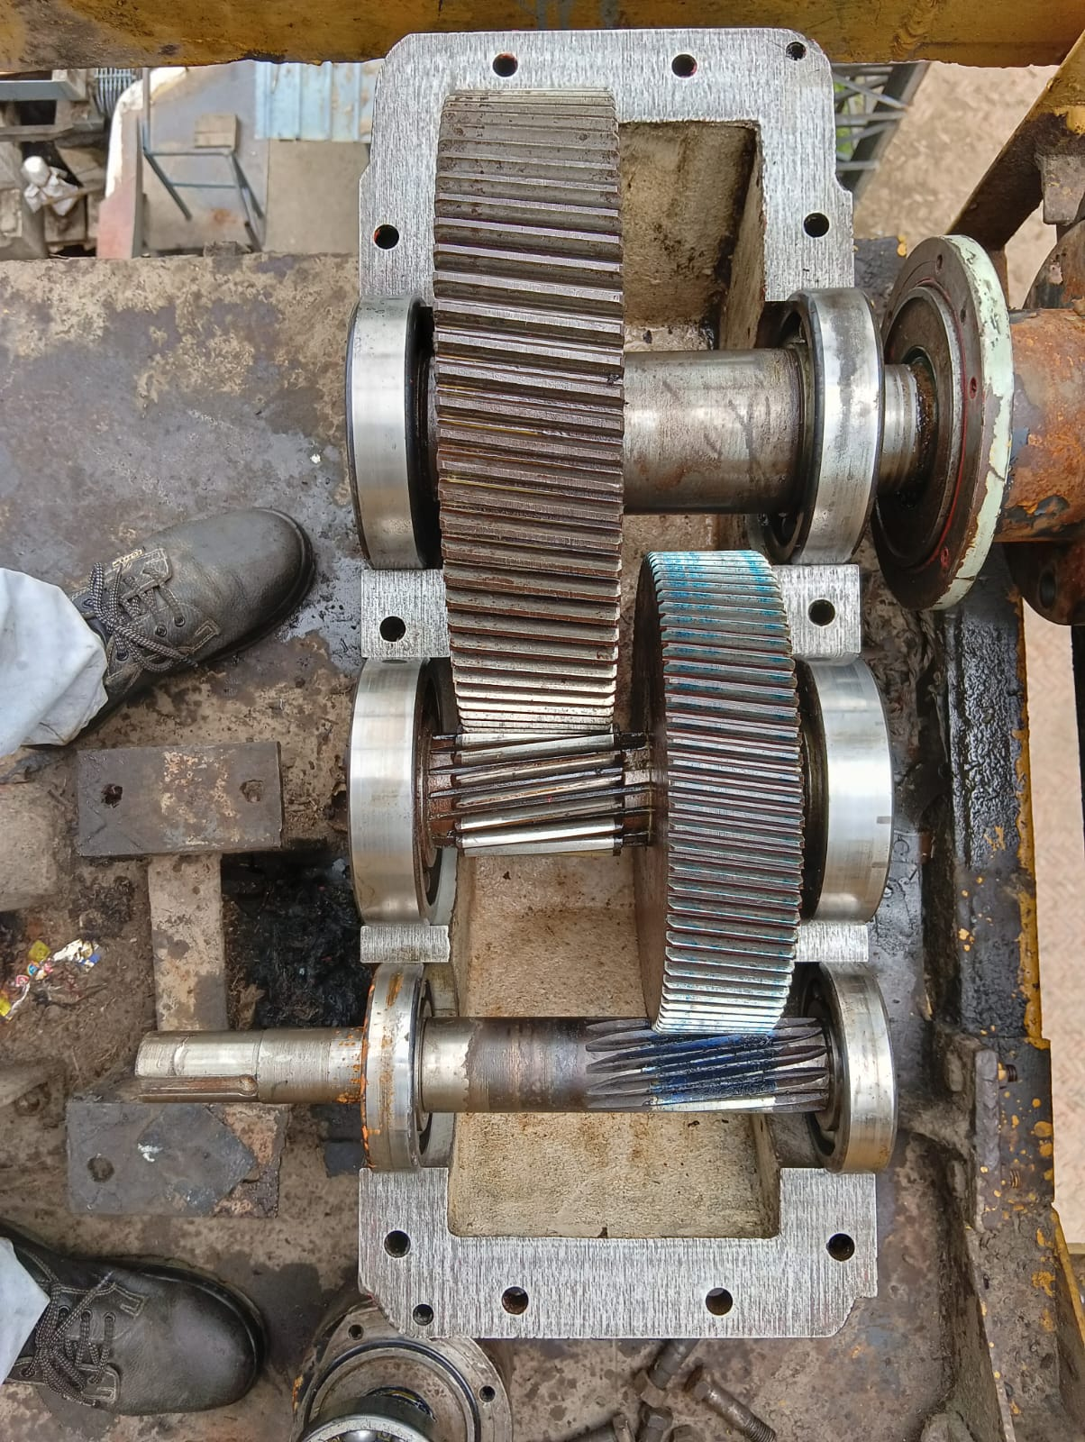
SBN 630 Gear Box for Mill No-1,2,3,& 4 Report (off Season 2025)
Observation Noted
Heavy pitting found output shaft at mill & turbine side bottom cover bearing seat for all mill FMG.
Minor pitting found of out put shaft top bearing cover bearing seat for all mill FMG
Minor pitting found at gear & Pinion teeth of output shaft for all mill FMG
Minor pitting on gear & Pinion Teeth 02 Nos out of 18 nos.
Minor Chip out on gear teeth 09 nos. out of 61 nos. teeth
Impression also found on bearing outer race. Bearing Rollers found OK. Present bearing 23064 b clearance 0.27 mm/0.35 mm(T/M)
Pitting found at mill side top cover bearing seat.
Gear teeth condition found okay (Minor Scratch

Slide 48
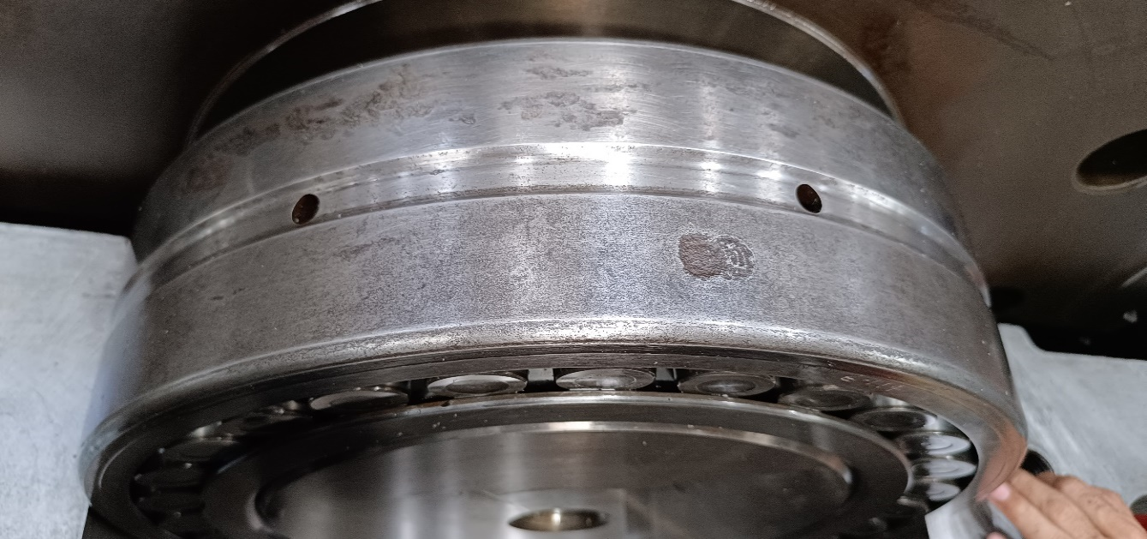
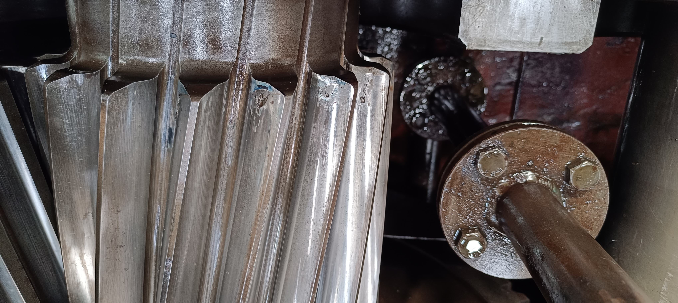
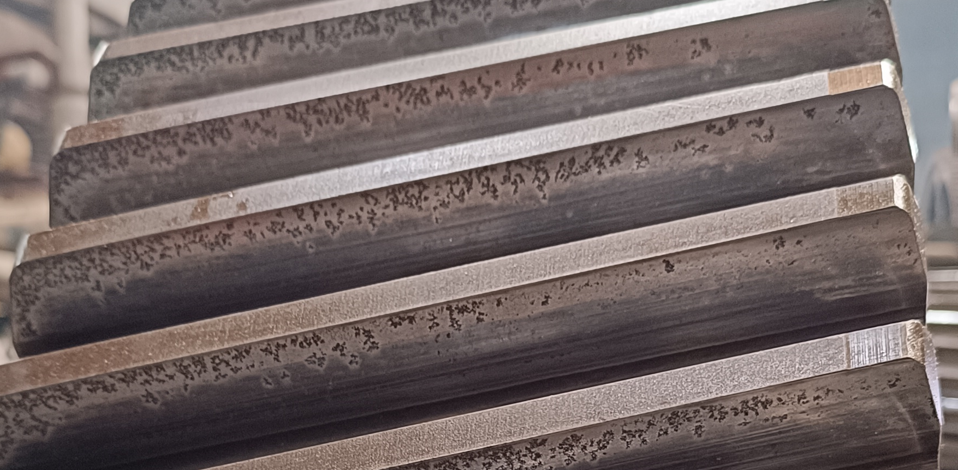
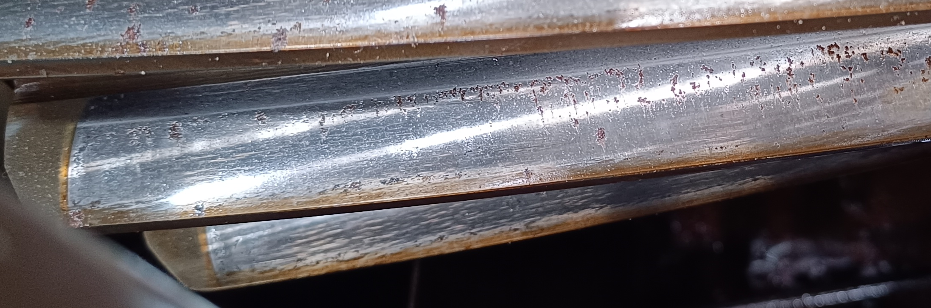
SBN 630 Gear Box for Mill No-1 & 2 Report (off season 2025 )
1st MILL OUTPUT SHAFT
Outer race impression & Bearing Roller minor pitting Found
Heavy pitting found at mill side & turbine side bottom bearing seat.
1ST MILL INTERMEDIATE SHAFT
Minor teeth chip out 9 Nos out of 18 teeth .
2ND MILL INTERMEDIATE GEAR SHAFT
Pitting found on pinion teeth 3Nos out of 18
2ND MILL INTERMEDIATE GEAR SHAFT
Pitting found on Gear teeth 13Nos out of 69 Teeth

Slide 49
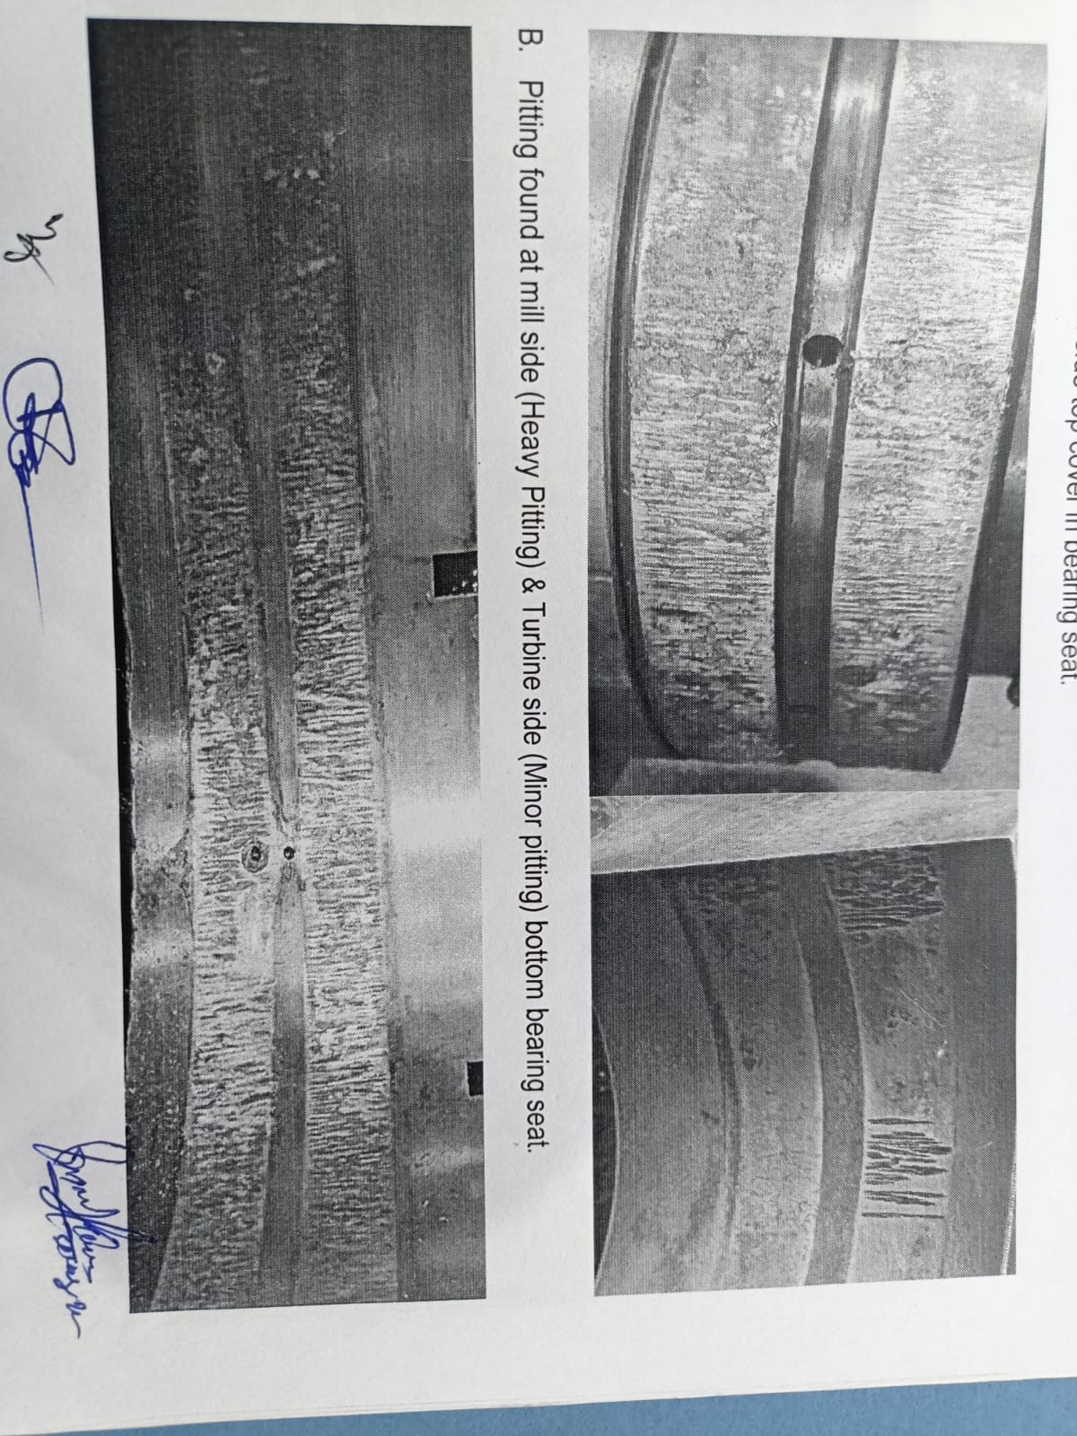
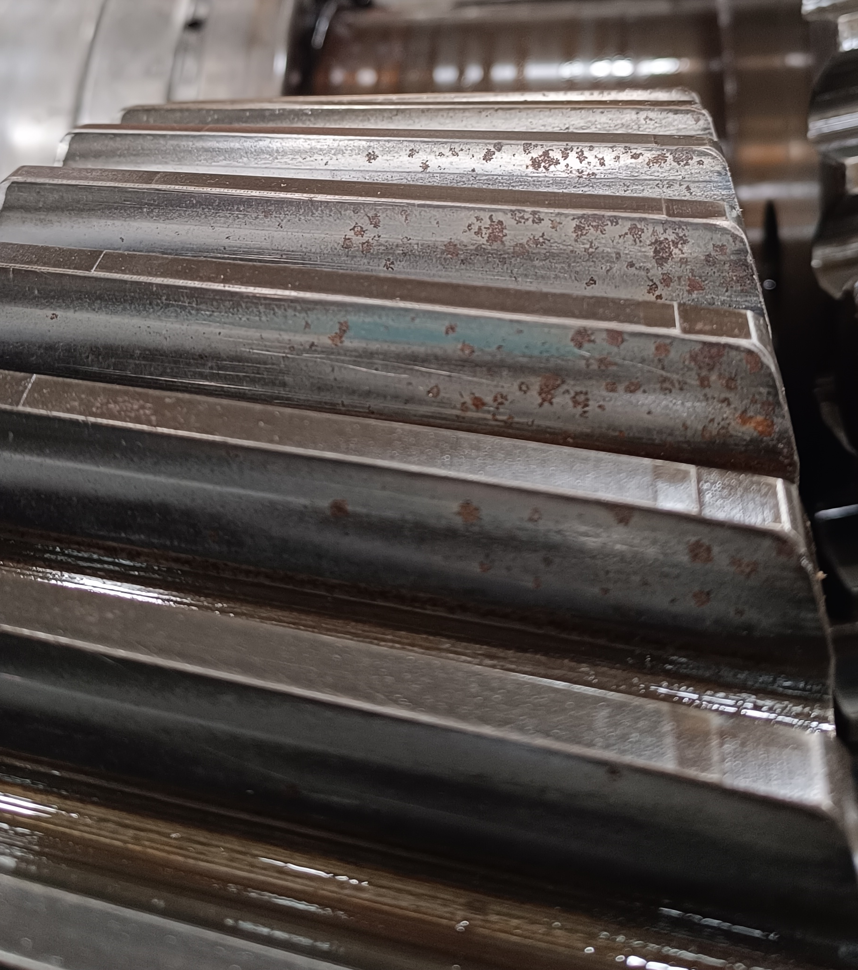
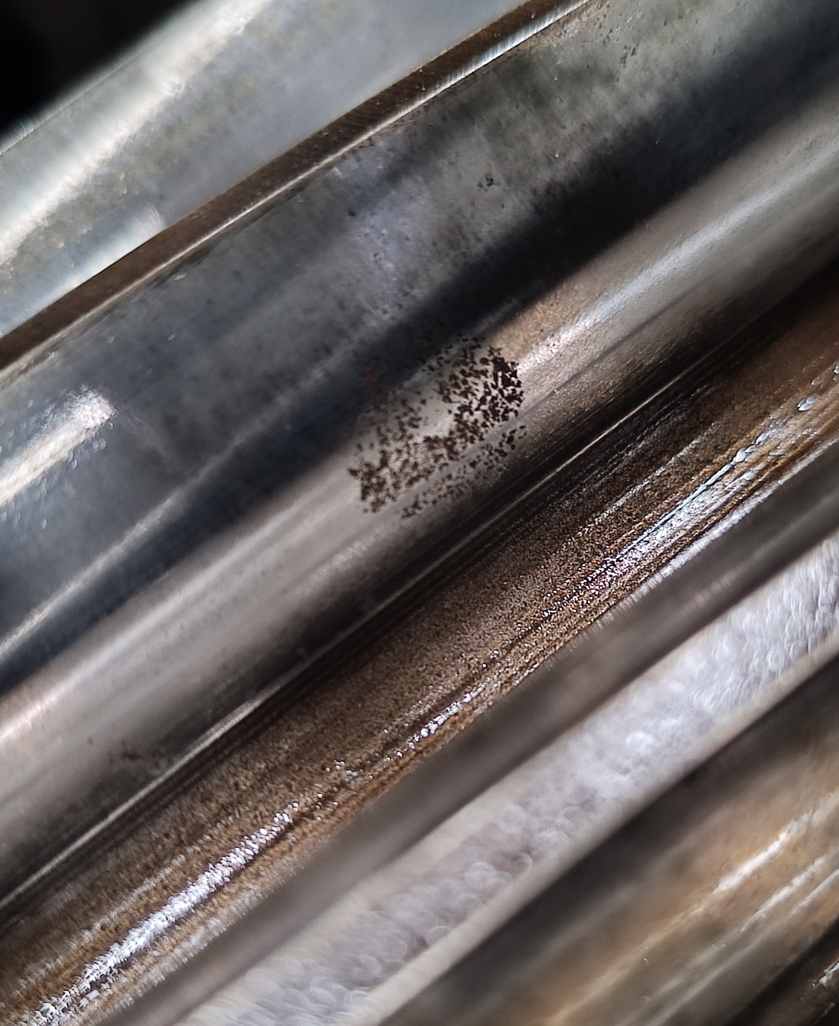
SBN 630 Gear Box for Mill No-3 Report (off season 2024 & 2025 )
3rd MILL OUTPUT SHAFT
Outer race impression & Bearing Roller minor pitting Found
Heavy pitting found at mill side & turbine side bottom bearing seat.
Inspection Report 2024 off Season
3rd MILL INTERMEDIATE GEAR SHAFT
Pitting found at gear teeth 9 out off 61 teeth.
Inspection Report 2025 off Season
3rd MILL INTERMEDIATE PINION SHAFT
Pitting found on pinion teeth 2Nos out of 18 Teeth.

Slide 50
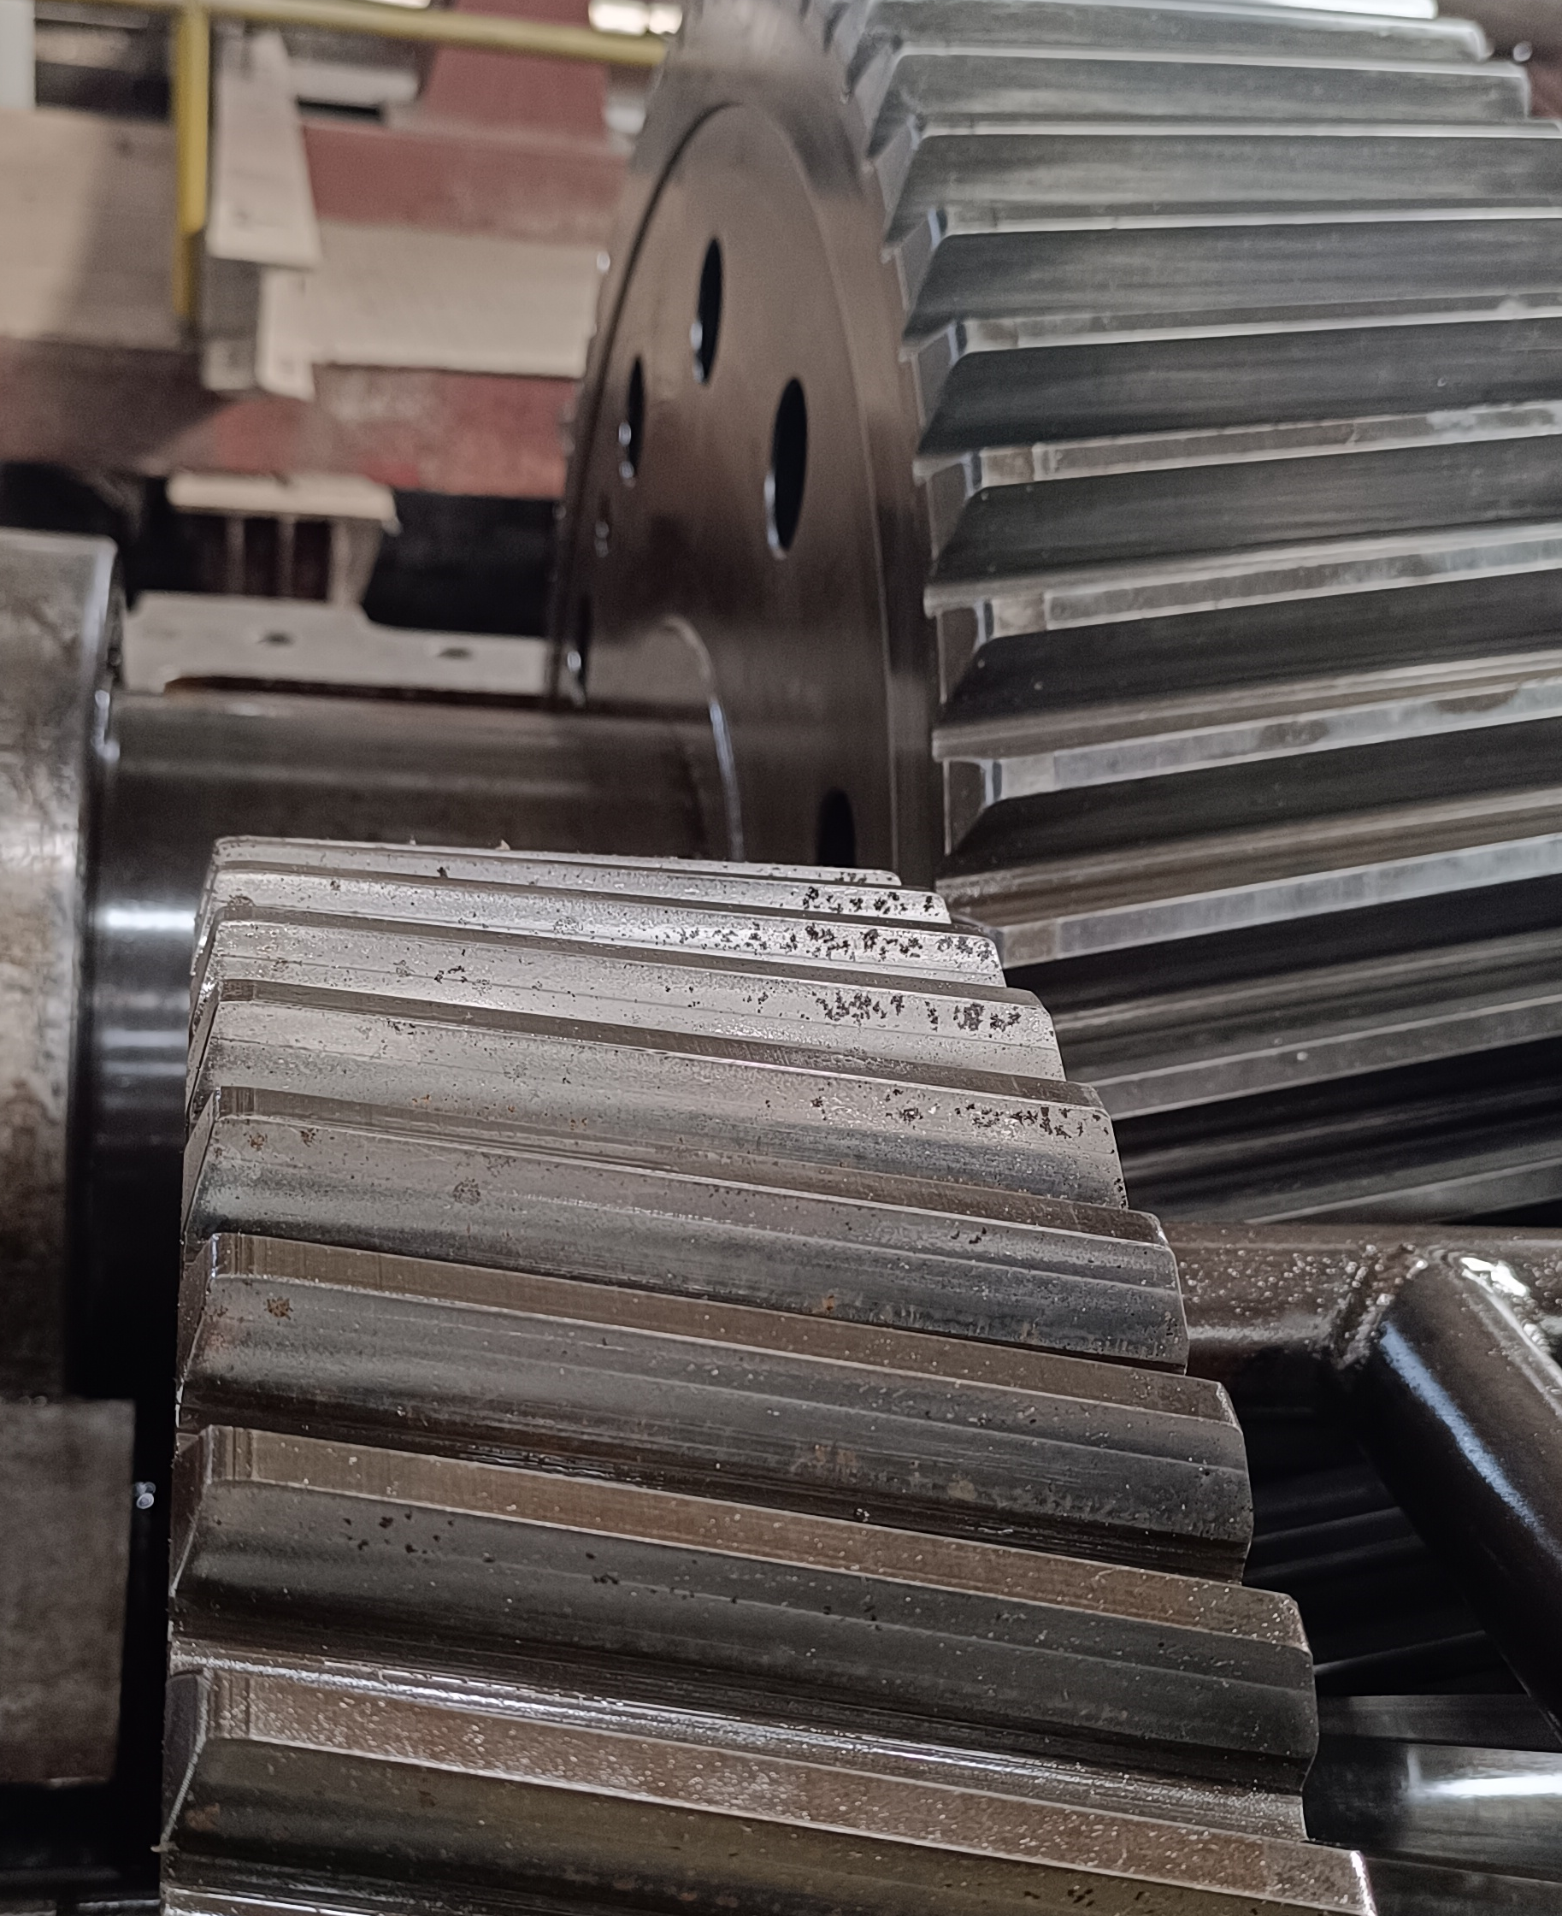
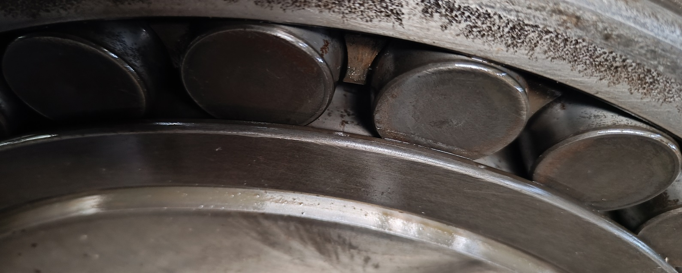
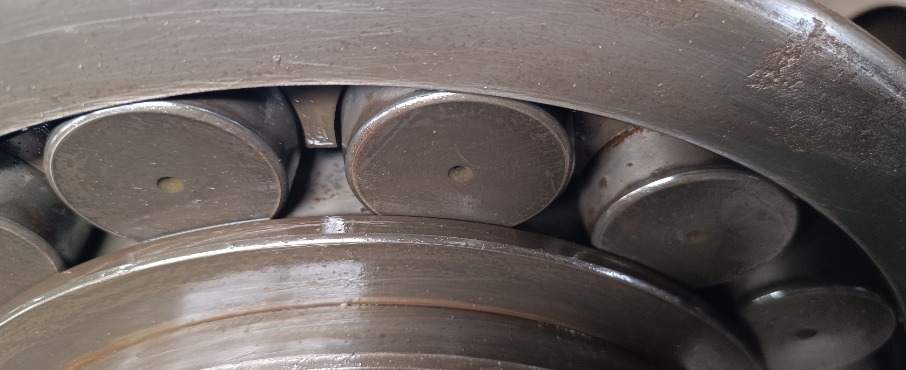
SBN 630 Gear Box for Mill No-4 Report (off season 2025)
4th MILL INTERMEDIATE GEAR SHAFT
Pitting found at gear teeth 16 out off 61 teeth.
4th output gear shaft
Outer race impression & Bearing Roller minor pitting Found
Heavy pitting found at mill side & turbine side bottom bearing seat.
4th MILL INTERMEDIATE PINION SHAFT
Pitting found on pinion teeth 4 Nos out of 18 Teeth.

Slide 51
SBN 630 Gear Box for Mill No-1,2,3,& 4 Overhauling Report off season 2023 to 2025
Sr. No. | Item Description | Observation O/S 2025 | Observation O/S 2024 | Observation O/S 2023 | Remark
1 | MILL NO. 1 FMG GEAR BOX (SBN-630) Sr.No.WHG16569LH
A | Input pinion
i | Input pinion Bearing Seat ,Top Cover Seat & pinion teeth | Minor pitting | Minor pitting | Minor pitting
B | Intermediate Gear
i | Intermediate pinion | Minor pitting / chip out 9 teeth out of 18 | Minor pitting | Minor pitting | Increase to last year
C | Output Gear
i | Output gear bearing seat in top cover DE | Minor pitting | Minor pitting | Minor pitting
ii | Output gear bearing seat in bottom cover DE | Heavy pitting | Heavy pitting | Heavy pitting
ii | Output gear bearing seat in top cover NDE | Minor pitting | Minor pitting | Minor pitting
iv | Output gear bearing seat in bottom cover NDE | Heavy pitting | Heavy pitting | Heavy pitting
v | Output gear teeth | Minor pitting / Scratch | Minor pitting / Scratch | Minor pitting / Scratch
2 | MILL NO. 2 FMG GEAR BOX (SBN-630) Sr.No.WHG16559LH
A | Input pinion
i | Input pinion Bearing Seat ,Top Cover Seat & pinion teeth | Minor pitting Starting stage | Minor pitting Starting stage | Minor pitting Starting stage
B | Intermediate Gear
i | Intermediate pinion | Minor pitting out 3 teeth out of 18 Starting stage | Minor pitting | Minor pitting out Starting stage | Increase to last year
C | Output Gear
i | Output gear bearing seat in top cover DE | Minor pitting | Minor pitting | Minor pitting
ii | Output gear bearing seat in bottom cover DE | Heavy pitting | Heavy pitting | Heavy pitting
ii | Output gear bearing seat in top cover NDE | Minor pitting | Minor pitting | Minor pitting
iv | Output gear bearing seat in bottom cover NDE | Heavy pitting | Heavy pitting | Heavy pitting
v | Output gear teeth | Minor pitting / chip out 13 teeth out of 69 | Minor pitting Starting stage | Minor pitting Starting stage | Increase to last year

Slide 52
SBN 630 Gear Box for Mill No-1,2,3,& 4 Overhauling Report off season 2023 to 2025
Sr. No. | Item Description | Observation O/S 2025 | Observation O/F 2024 | Observation O/F 2023 | Remark
3 | MILL NO. 3 FMG GEAR BOX (SBN-630) Sr.No.WHG16422 LH Make
A | Input pinion
i | Input pinion gear teeth | Minor pitting | Minor pitting | Minor pitting
B | Intermediate Gear
i | Intermediate gear teeth | Minor pitting / chip out 09 teeth out of 61 | Minor pitting | Minor pitting | Increase to last year
ii | Intermediate pinion | Minor pitting / chip out 02 teeth out of 18 | Minor Scratch | Minor Scratch | Increase to last year
C | Output Gear
i | Output gear bearing seat in top cover DE | Minor pitting | Minor pitting | Minor pitting
ii | Output gear bearing seat in bottom cover DE | Heavy pitting | Heavy pitting | Heavy pitting
ii | Output gear bearing seat in top cover NDE | Minor pitting | Minor pitting | Minor pitting
iv | Output gear bearing seat in bottom cover NDE | Heavy pitting | Heavy pitting | Heavy pitting
v | Output gear teeth | Minor Scratch/ pitting | Minor Scratch/ pitting | Minor Scratch/ pitting
4 | MILL NO. 4 FMG GEAR BOX (SBN-630) Sr.No.WHG16393 LH Make
A | Input pinion
i | Input pinion gear teeth | Minor pitting | Minor pitting | Minor pitting
B | Intermediate Gear
i | Intermediate gear teeth | Minor pitting / chip out 16 teeth out of 61 | Minor pitting | Minor pitting | Increase to last year
ii | Intermediate pinion | Minor pitting / chip out 04 teeth out of 18 | Minor pitting | Minor pitting | Increase to last year
C | Output Gear
i | Output gear bearing seat in top cover DE | Pitting Found | Pitting Found | Minor pitting
ii | Output gear bearing seat in bottom cover DE | Heavy pitting | Heavy pitting | Minor pitting
ii | Output gear bearing seat in top cover NDE | pitting Found | pitting Found | Pitting Found
iv | Output gear bearing seat in bottom cover NDE | Heavy pitting | Heavy pitting | Heavy pitting
v | Output gear teeth | Minor Scratch | Minor Scratch | Pitting Found

Slide 53
SBN 630 Gear Box for Mill No-1,2,3,& 4 Spare part offer By OEM
Total Rs 53,05,130

Slide 54
SBN 630 Gear Box for Mill No-1,2,3,& 4 Spare part Servicing offer By OEM

Slide 55
New FMG offer for SBN 630 by OEM

Slide 56
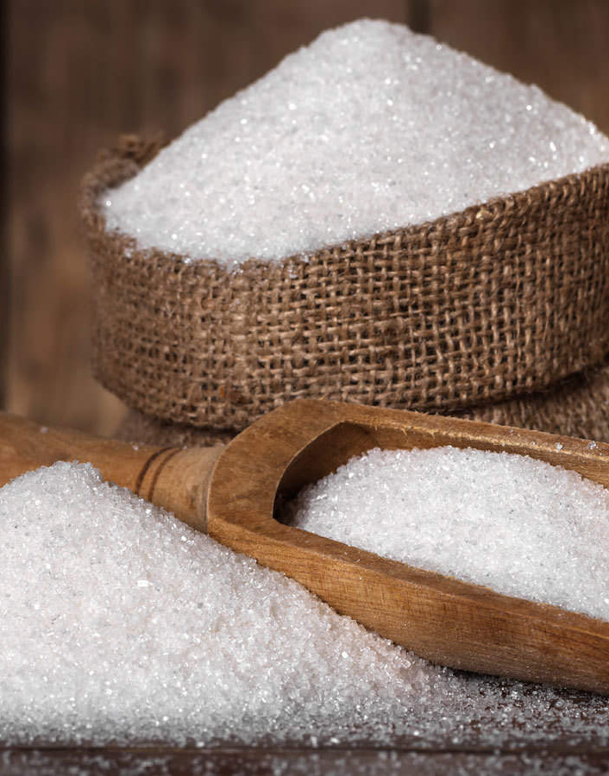
PRODUCTION

Slide 57
General Observation
Mud removal system all pipeline laying work completed. Electrical and instrument cable laying is in progress.
R3 massecuite boiling system has been taken into operation in all respects.

Slide 58
MRS Project – Work Progress and Delay Analysis
Target Completion date - 30th October 2025
Estimated Project Completion date – 10th January 2026
SN | Work Description |  | PO date | Completion/Material Received date as per PO | Actual Date Of start | Actual Date Of start | Actual Completion/Material Recieved date | Total days Delay in work
1 | Civil | Foundation | 05/08/2025 | 05/10/2025 | 01/08/2025 | 5th August 2025 | 16/12/2025 | 71 days
 |  | Column
 |  | Slab
2 | MRS material | Decanter | 19/06/2025 | 25/08/2025 |  |  | Last consignment received on 07/09/2025 | 12 days
 |  | Pumps with Motor
 |  | Electrical and Instrument accessories
3 | Erection of tanks and pumps | Equipment Shifting | 10/10/2025 | 30/10/2025 | 17/12/2025 | 17th Dec 2025 | Under Progress | Dependent on completion of civil work
 |  | Pumps and valve Installation
 | Erection and commissioning | Decanter Levelling | 10/10/2025 | 30/10/2025
 |  | Panel installation
 |  | Instrument and Electrical connection
Key Observations
1-Civil work completion was delayed by 71 days, which directly impacted downstream activities.
2-MRS material supply was delayed by 12 days, though fully received later.
3-Fabrication and erection activities could not start as planned due to pending civil work.
4-Erection and commissioning activities commenced only after civil readiness.

Slide 59
Weekly Performance Snapshot - Production
No. | Capacity Utilization | Target | Current Week | Last Week | Till Date
1 | Sugar Production (LQ) | 15.26 | 0.65 | 0.65 | 5.13
2 | Sugar Bagging – RS (Qtl) | 824250 | 39033 | 40069 | 316263
3 | Sugar Bagging – DS (Qtl) | 702139 | 26264 | 25371 | 197509
 | Recovery
4 | Sugar Recovery CH – RS (%) | 10.14 | 11.19 | 11.18 | 10.09
5 | Sugar Recovery CH – DS (%) | 10.14
6 | Sugar Recovery BH – RS (%) | 10.69
7 | Sugar Recovery BH – DS (%) | 10.69 | 9.44 | 9.46 | 9.58
8 | C-Mol Recovery – RS (%) | 4.80 | 3.90 | 4.20 | 4.11
9 | B-Mol Recovery – DS (%) | 7.20 | 7.18 | 6.45 | 7.07
 | Quality
10 | C-Mol Purity – RS | < 33.00 | 32.29 | 33.21 | 32.21
11 | B-Mol Purity – DS | < 51.00 | 50.66 | 50.62 | 50.63
12 | Losses in Mol % Cane CH – RS | < 1.39 | 1.15 | 1.11 | 1.17
13 | Losses in Mol % Cane BH – DS | < 3.18 | 2.88 | 2.83 | 2.83
14 | Pol % Filter cake | < 2.00 | 1.90 | 2.00 | 2.00
 | Consumption
15 | Steam Consumption (Kg/Qtl Sugar) | 400 | 454 | 450 | 490
16 | Steam % Cane | <42 | 39.49 | 39.52 | 39.94
17 | Power Consumption (Units/Qtl Sugar) | 11 | 11.62 | 11.86 | 11.65
59

Slide 60
Weekly Sugar Production – DS House
Production Plan for Next Week
SKU | Quantity (Qtls) | % of Total
L | 0 | 0
M | 19859 | 90
S | 2206 | 10
Total | 22065 | 100

Slide 61
Weekly Sugar Production – RS House
Production Plan for Next Week
SKU | Quantity (Qtls) | % of Total
L | 3663 | 10
M | 25641 | 70
S | 5494 | 15
Pharma | 1831 | 5
Total | 36629 | 100
Icing | 5 | 0.32
Bura | 155 | 9.78
Sachet | 140 | 8.83
1kg pack | 400 | 25.24
5kg pack | 200 | 12.62
Superfine | 75 | 4.73
Brown 1kg | 110 | 6.94
Pharma | 500 | 31.54
Total | 1585 | 100%

Slide 62
Sugar Production Quality
Sugar Quality | Season 2025-26 |  |  |  | Season 2024-25
 | Target | Current Week | Last Week | Till Date | Week | Till Date
Sugar Quality - DS
ICUMSA (L-sugar) | <110
ICUMSA (M-sugar) |  | 92 | 103 | 107 | 115 | 122
ICUMSA (S-sugar) |  | 98 | 112 | 109 | 116 | 123
Sugar Quality – RS
ICUMSA (L-sugar) | <30 | 29 | 32 | 33 | 34 | 34
ICUMSA (M-sugar) |  | 29 | 33 | 33 | 34 | 35
ICUMSA (S-sugar) |  | 31 | 35 | 34 | 36 | 37
Sugar Quality Pharma
ICUMSA (SS - Sugar) | <25 | 30 | 30 | 32
ICUMSA (20/80 - Sugar) |  | 28 | 30 | 31 | 30 | 31
ICUMSA (30/80 - Sugar) |  | 26 | 30 | 31 | 34 | 33

Slide 63
Monthly Performance Snapshot - Production
S.No. | Capacity Utilization | Target | Nov.-25 | Nov.-24
1 | Sugar Production (LQ) | 15.26 | 2.62 | 2.12
2 | Sugar Bagging – RS (Qtl) | 824250 | 166302 | 120188
3 | Sugar Bagging – DS (Qtl) | 702139 | 95920 | 91961
 | Recovery
4 | Sugar Recovery CH – RS (%) | 10.14 | 9.39 | 9.28
5 | Sugar Recovery CH– DS (%) | 10.14 | 9.40 | 9.13
 | Sugar Recovery BH – RS (%) | 10.69
 | Sugar Recovery BH– DS (%) | 10.69
6 | C-Mol Recovery – RS (%) | 4.8 | 4.41 | 4.65
7 | C-Mol Recovery – DS (%) | 5.2 | 3.86 | 4.62
8 | B-Mol Recovery – RS (%) | 6.8
9 | B-Mol Recovery – DS (%) | 7.2
 | Quality
10 | C-Mol Purity – RS | <33.00 | 31.21 | 32.23
11 | C-Mol Purity – DS | <32.00 | 30.07 | 31.86
12 | B-Mol Purity – RS | <51.00
13 | B-Mol Purity – DS | <51.00
14 | Losses in Mol % Cane CH– RS | <1.39 | 1.20 | 1.40
15 | Losses in Mol % Cane CH – DS | <1.46 | 1.23 | 1.41
16 | Losses in Mol % Cane BH – RS | <3.00
17 | Losses in Mol % Cane BH – DS | <3.18
18 | Pol % Filter Cake | <2.00 | 2.05 | 1.95
 | Consumption
19 | Steam Consumption (Kg/Qtl Sugar) | 400 | 532 | 580
20 | Steam % Cane | 42 | 40.09 | 40.83
21 | Power Consumption (Units/Qtl Sugar) | 11 | 13.03 | 12.91

Slide 64
Monthly Performance Snapshot - Production
Steam consumption target Vs actual at different process
At Recovery % | Process option - 1 |  |  | Process option - 2 |  |  | Process option - 3
 | RS & DS on C-heavy with 125 KLD Distillery on Syrup |  |  | Both process on B-heavy with 125 KLD Distillery on Syrup |  |  | Both process on B-heavy
 | Target | Weak actual | Actual till date | Target |  | Till date | Target | Weak actual | Actual Till date
10.50 | 42.00 | 39.52 | 39.94 | 40.07 |  |  | 41.00

Slide 65
Capex Job Status
S. No. | Project Name | Objective of Project | Scope | Budget Approved | % Progress | Status
Speciality
1 | Dehumidification system ( consumer section ) | EIP | off Season 2025 | 25 | 0 | Budget will be used for IER column
2 | Pharma Sugar reprocessing and packing room dehumidification system. | EIP | off Season 2025 | 20 | 100
3 | Roofing of retail section with Puff panels | EIP | off Season 2025 | 11 | 0
4 | Dust collector for sugar screening room | EIP | off Season 2025 | 4 | 100 | Work Completed
5 | Pharma section side wall replacement with puff panel | Compliance | off Season 2025 | 5 | 100 | Work Completed
DS House
6 | Replacement of existing arms with ribbon type arms in crystallizer no 8. | RIP | off Season 2025 | 4 | 100 | Work Completed
7 | Mud Removal system (Decanter) installation | EIP | off Season 2025 | 285 | 90 | Work in progress
8 | Repairing of center tube with mud seal ring replacement | EIP | off Season 2025 | 6 | 100 | Work Completed
9 | Fitting of magnets at various places | EIP | off Season 2025 | 10 | 100 | Work Completed
Refinery House
10 | Transfer of IER regeneration effulent for sprinkling in bagasse and ash handling unit at powerplant | EIP | off Season 2025 | 21 | 100 | Work in progress
11 | Refinery House SRT modification work by external expert | EIP | off Season 2025 | 102 |  | Postponed
12 | Recycling system of pump gland cooling water | EIP | off Season 2025 | 15 | 30 | Work in progress. Rs 10 Lacs will be used for IER.
13 | Modification of Static screen | EIP | off Season 2025 | 10 | 100 | Completed
14 | Modification of existing 1 no's mechanical circulator blades at raw and refinery pan. | EIP | off Season 2025 | 8 |  | Hold due to delay in delivery.Budget will be used for IER column
15 | Cooled condensate pump capacity @ 80 M3/hr. needs to be increased up to 130 M3/hr. | EIP | off Season 2025 | 3 | 100 | Work Completed
16 | Installation of plough assembly at Raw and refinery batch centrifugal( 5 no's) | EIP | off Season 2025 | 6 | 100 | Work Completed
17 | Portable dust collector 3 Nos | EIP | off Season 2025 | 10 | 100 | Work Completed
18 | Two nos. hot air blower required for JT-2 chute area | EIP | off Season 2025 | 5 | 100 | Work completed
19 | R3 boiling and curring arrangement | EIP | off Season 2025 | 2 | 100 | Work completed
20 | Hydrojet cleaning water decanter pits | EIP | off Season 2025 | 3 | 100 | Work completed
21 | Vacuum Safety device installation | EIP | off Season 2025 | 3 | 100 | Work completed

Slide 66
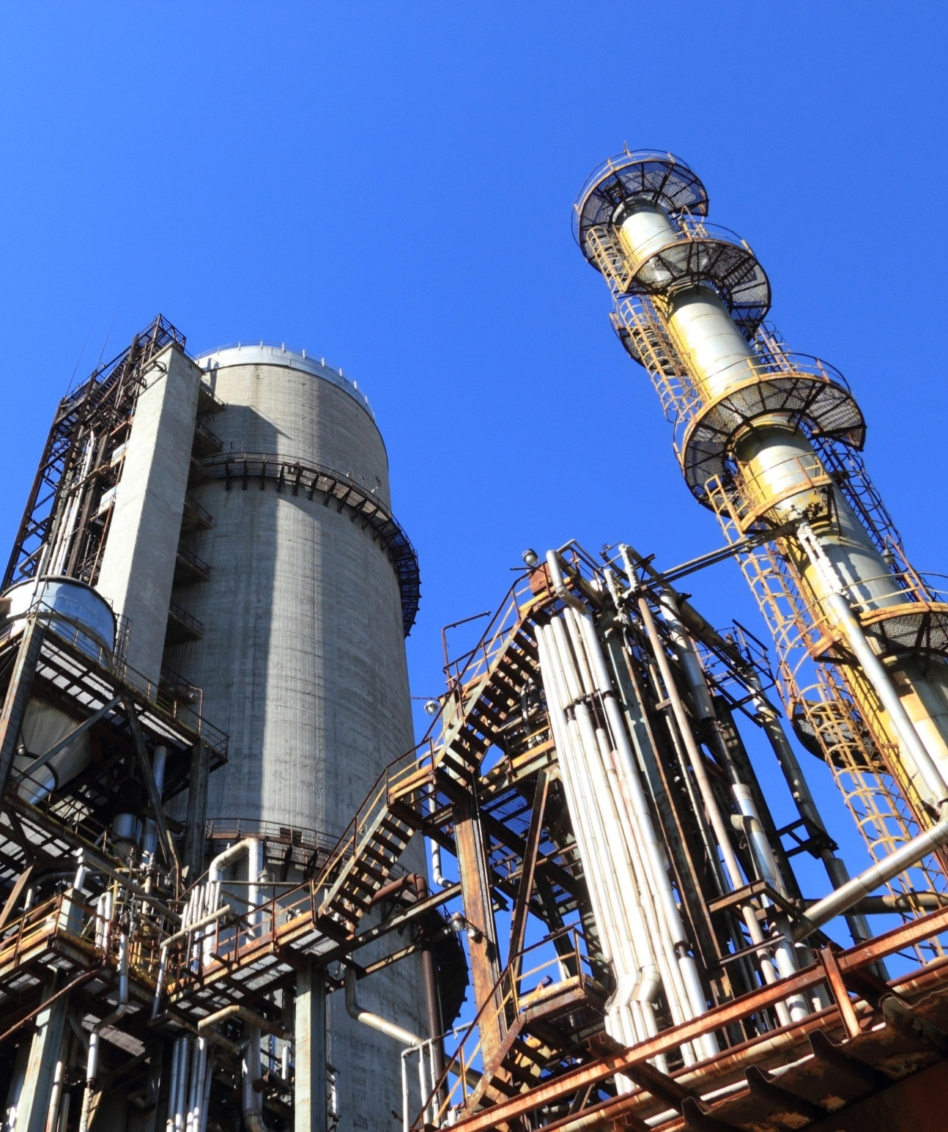
POWER PLANT

Slide 67
HIGHLIGHTS FOR THE WEEK
30.85 MW Power Plant The 30.85 MW Co-generation Plant is operating satisfactorily. All parameters of the 150 TPH Boiler and 30.85 MW Turbine were observed to be within normal limits during full-load operation. Avg. Steam Flow :151.2 TPH & Avg. TG load 29.01 MW. The extraction steam pressure supplied to the sugar process has been increased from 1.03–1.05 kg/cm² to 1.17–1.20 kg/cm² in order to consistently maintain the required 1.0 kg/cm² pressure at the refinery end, considering future operating conditions and system design requirements. 70 TPH Boiler The 70 TPH boiler performed satisfactorily. Avg. Steam Flow :69.7 TPH 4.0 MW Distillery Power Plant The 4.0 MW Distillery Co-generation Plant is running satisfactorily. Avg steam load 33.10 TPH and Avg power load 3.97 MW with the slop consumption of 2.80 TPH.

Slide 68
Weekly Performance Snapshot - Power
S.N | Generation & Export | Current Week | Last Week |  | Till Date
1 | Total Power Generation (LU) | 64.71 | 65.38 |  | 572.46
2 | Power Export (LU) | 36.92 | 38.00 |  | 338.93
3 | Power Export (%) | 57.05 | 58.12 |  | 59.21
 | Power Consumption (% of Gen.) | 42.95 | 41.88 |  | 40.79
4 | Sugar Plant Process (% of Gen. ) | 30.90 | 29.93 |  | 28.39
5 | Distillery Plant Process (% of Gen. ) | 4.04 | 4.00 |  | 3.94
6 | Aux Consumption (% of Gen.) | 8.01 | 7.95 |  | 8.47
Remarks
1 | Less power Generation due to Increased Steam Pr. of Sugar Process (1.03 to 1.20 Kg/cm2) |  |  | - 0.67 LU |  | - 1.02 %
2 | Less power Export due to increase house consumption (by Shredder motor & others) & decrease generation (1.08%). |  |  | - 1.08 LU |  | - 2.84 %
68

Slide 69
Weekly Performance Snapshot – Power
 | Boiler Capacity Utilization | Target | Current Week | Last Week | Till Date (25-26) | Till Date (24-25)
1 | Capacity Utilization - 150 TPH | >144.0 | 151.2 | 151.3 | 150.6 | 141.6
2 | Capacity Utilization – 70 TPH | >64.0 | 69.7 | 70.1 | 67.4 | 65.0
3 | Capacity Utilization – 35 TPH | >33.0 | 33.1 | 33.5 | 32.8 | 31.8
 | Turbine Capacity Utilization
4 | PLF % – 30.85 MW | > 95.00 | 96.69 | 97.96 | 97.16 | 91.90
5 | PLF % – 3.0 MW (O) | > 90.00 | 94.60 | 95.29 | 94.06 | 92.62
6 | PLF % – 3.0 MW (N) | > 75.00 | 90.34 | 90.15 | 86.52 | 79.40
7 | PLF % – 4.0 MW | > 90.00 | 99.14 | 99.23 | 95.94 | 87.84
 | Efficiency
8 | Steam/Fuel Ratio – 150 TPH | ≥2.54 | 2.56 | 2.56 | 2.55 | 2.51
9 | Steam/Fuel Ratio – 70 TPH | ≥2.19 | 2.22 | 2.22 | 2.20 | 2.16
10 | Steam/Fuel Ratio – 35 TPH | ≥1.88 | 2.16 | 2.19 | 2.17 | 2.04
11 | Specific Steam – 30.85 MW | <5.20 | 5.20 | 5.15 | 5.13 | 5.11
12 | Specific Steam – 3 MW (O) | <9.00 | 8.62 | 8.64 | 8.49 | 8.62
13 | Specific Steam – 3 MW (N) | <9.00 | 8.81 | 8.84 | 8.75 | 8.93
14 | Specific Steam – 4 MW | <9.20 | 8.34 | 8.44 | 8.60 | 9.01
69

Slide 70
Key Operational Parameters: Overall SPE Division
Plant Availability
Sr. No. | Description | Current Week | Last Week |  | Till Date SS 25 - 26 | Till Date SS 24 - 25
 |  | 21/12/2025 to 27/12/2025 | 14/12/2025 to 20/12/2025 |  | 26/10/2025 to 27/12/2025 | 26/10/2024 to 27/12/2024
1. | 150 TPH Boiler | 100% | 100% |  | 99.98% | 97.45%
2. | 70 TPH Boiler | 100% | 100% |  | 99.62% | 99.46%
3. | 35 TPH Boiler | 100% | 100% |  | 99.17% | 97.61%
4. | 30.85 MW Turbine | 100% | 100% |  | 99.85% | 96.82%
5. | 4 MW Turbine | 100% | 100% |  | 98.80% | 96.85%
6. | 3 MW_Old Turbine | 100% | 100% |  | 99.40% | 99.11%
7. | 3 MW_New Turbine | 100% | 100% |  | 97.37% | 95.55%
8. | 132 KV GRID | 99.65% | 99.79% |  | 99.87% | 99.73%

Slide 71
Key Operational Parameters: Overall Power Generation , Export and Consumption of SPE Division
Sr. No. | Particulars | UOM | Target | Current Week |  | Last Week |  | Till date SS 25-26 |  | Till date SS 24-25
 | Operation | Days | Avg. | 7 | Avg. | 7 | Avg. | 63 | Avg. | 62 | Avg.
1. | 30.85 MW STG | MWH | 28.50 | 4873.00 | 29.01 | 4937.00 | 29.39 | 44073.00 | 29.15 | 41024.00 | 27.57
2. | 3 MW _Old STG | MWH | 2.70 | 476.77 | 2.84 | 480.24 | 2.86 | 4063.45 | 2.82 | 4134.39 | 2.78
3. | 3 MW _ New STG | MWH | 2.25 | 455.29 | 2.71 | 454.35 | 2.70 | 3675.33 | 2.60 | 3373.10 | 2.27
4. | 4.0 MW STG | MWH | 3.60 | 666.20 | 3.97 | 666.80 | 3.97 | 4975.30 | 3.84 | 5434.00 | 3.65
5. | Power Exported | MWH | 22.00 | 3692.00 | 21.98 | 3800.00 | 22.62 | 33893.00 | 22.42 | 31838.00 | 21.40
6. | Sugar Plant Consumption | MWH | 10.44 | 1996.06 | 11.88 | 1954.59 | 11.63 | 16546.11 | 10.94 | 14900.49 | 10.01
7. | Distillery Plant Consumation | MWH | 1.60 | 261.64 | 1.56 | 261.69 | 1.56 | 2252.73 | 1.59 | 2215.86 | 1.56
8. | 30 MW Cogen Aux. Cons. | MWH | 2.70 | 404.17 | 2.41 | 406.25 | 2.42 | 3675.67 | 2.43 | 3676.63 | 2.47
9. | 4.0 MW Cogen Aux. Cons. | MWH | 0.80 | 99.76 | 0.59 | 99.51 | 0.59 | 858.68 | 0.61 | 857.14 | 0.61

Slide 72
Key Operational Parameters: Overall Power Generation , Export and Consumption of SPE Division
Sr. No. | Particulars | UOM | Target | Current Week | Last Week | Till date SS 25-26 | Till date SS 24-25
 | Operation | Days | Avg. | 7 | 7 | 63 | 62
1. | Capacity Utilization – 30.85 MW STG Set | % | > 95.00 | 96.69 | 97.96 | 97.16 | 91.90
2. | Capacity Utilization – 3.0 MW _ Old STG Set | % | > 90.00 | 94.60 | 95.29 | 94.06 | 92.62
3. | Capacity Utilization – 3.0 MW _ New STG Set | % | > 75.00 | 90.34 | 90.15 | 86.52 | 79.40
4. | Capacity Utilization – 4.0 MW STG Set | % | > 80.00 | 99.14 | 99.23 | 95.94 | 87.84
5. | Aux. Consumption of 30.85 MW | % | < 9.20 | 8.29 | 8.23 | 8.34 | 8.96
6. | Aux. Consumption of 4 MW | % | < 20.00 | 14.97 | 14.92 | 15.72 | 17.23
7. | Power Consumption Per Ton of Cane Crushed | KWH/Ton on Cane | < 31.54 | 31.96 | 31.75 | 32.03 | 32.71

Slide 73
KEY OPERATIONAL PARAMETERS 30.85 MW PP (150 TPH BOILER)
Parameters | UOM | DATE
 |  | 21-Dec | 22-Dec | 23-Dec | 24-Dec | 25-Dec | 26-Dec | 27-Dec
Cane Crushed | QTL | 106500 | 107500 | 107000 | 110000 | 107000 | 105500 | 107500
Steam Gen. | MT/ HR | 151.4 | 151.2 | 150.2 | 151.5 | 151.4 | 151.2 | 151.2
Power Gen. | MWH | 29.08 | 28.92 | 28.63 | 29.08 | 29.00 | 29.17 | 29.17
Bag. Moisture | % | 49.9 | 50.0 | 49.8 | 49.9 | 50.0 | 50.0 | 49.8
GCV : Bagasse | KCal/ Kg | 2284 | 2280 | 2289 | 2284 | 2280 | 2280 | 2289
Gross SHR of PP (Kcal/Kwh) | 25-26 | 2738 | 2699 | 2745 | 2703 | 2755 | 2789 | 2728
 | 24-25 | 2681 | 2717 | 2751 | 2745 | 2809 | 2822 | 2788
Gross Boiler Eff.(71.95as per PG test) | % | 71.02 | 71.17 | 71.15 | 71.23 | 71.07 | 71.06 | 71.21

Slide 74
BAGASSE GENERATION & CONSUMPTION DETAILS
Particulars | UOM
Operation days | NOS.
Cane Crushed | MT
Bagasse Received | MT
Bagasse Stock | MT
Steam% Cane | %
Hourly | Current Week | Last Week | Hourly (Till Date)
Target | SS 25-26 | SS 25-26 | SS 25-26 | SS 24-25
 | 7 | 7 | 63 | 62
416.7 | 447.0 | 442.6 | 417.6 | 381.7
112.5 | 121.4 | 120.0 | 112.3 | 102.0
 | 19010 | 15916 | 19010 | 27126
 | 39.49 | 39.52 | 39.94 | 41.07
Weekly | Current Week | Last Week
Target | SS 25-26 | SS 25-26
7 | 7 | 7
70000 | 75100 | 74350
18900 | 20387 | 20166
Till Date
SS 25-26 | SS 24-25
63 | 62
631420 | 567990
169744 | 151738
Steam Gen. 70 TPH Boiler | MT
Bag. Cons. 70 TPH Boiler | MT
Steam to Fuel Ratio
64.0 | 69.7 | 70.1 | 67.4 | 65.0
29.2 | 31.4 | 31.6 | 30.6 | 30.2
>2.19 | 2.22 | 2.22 | 2.20 | 2.16
10752 | 11710 | 11770
4906 | 5275 | 5302
>2.19 | 2.22 | 2.22
97125 | 96785
44111 | 44904
2.20 | 2.16
Steam Gen. 150 TPH Boiler | MT
Bag. Cons. 150 TPH Boiler | MT
Steam to Fuel Ratio
144 | 151.2 | 151.3 | 150.6 | 141.6
56.7 | 59.1 | 59.1 | 59.1 | 56.3
>2.54 | 2.56 | 2.56 | 2.55 | 2.51
24192 | 25396 | 25417
9526 | 9920 | 9929
>2.54 | 2.56 | 2.56
227725 | 210704
89411 | 83843
2.55 | 2.51
Steam Gen. (35 T Boiler) | MT
Bag. Cons. (35 T Boiler) | MT
Slop Cons. (35 T Boiler) | MT
Steam to Fuel Ratio
33.0 | 33.1 | 33.5 | 32.8 | 31.8
12.0 | 12.5 | 12.8 | 12.4 | 13.0
3.0 | 2.8 | 2.5 | 2.7 | 2.6
>1.88 | 2.16 | 2.19 | 2.17 | 2.04
5544 | 5568 | 5630
2016 | 2098 | 2153
504 | 475 | 421
>1.88 | 2.16 | 2.19
46434 | 45059
17622 | 18347
3814 | 3734
2.17 | 2.04

Slide 75
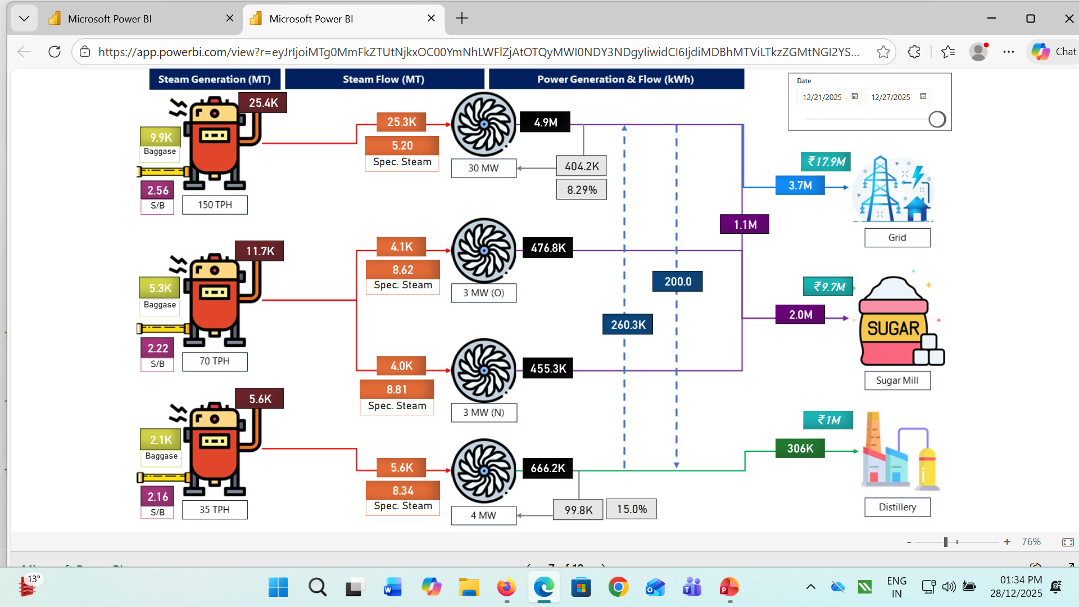
STEAM & POWER FOR THE WEEK

Slide 76
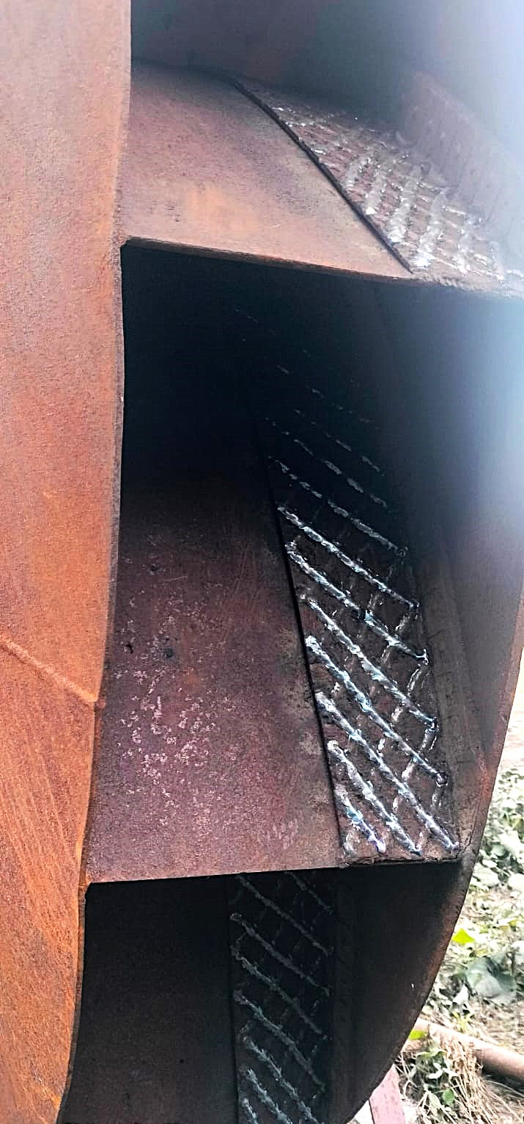
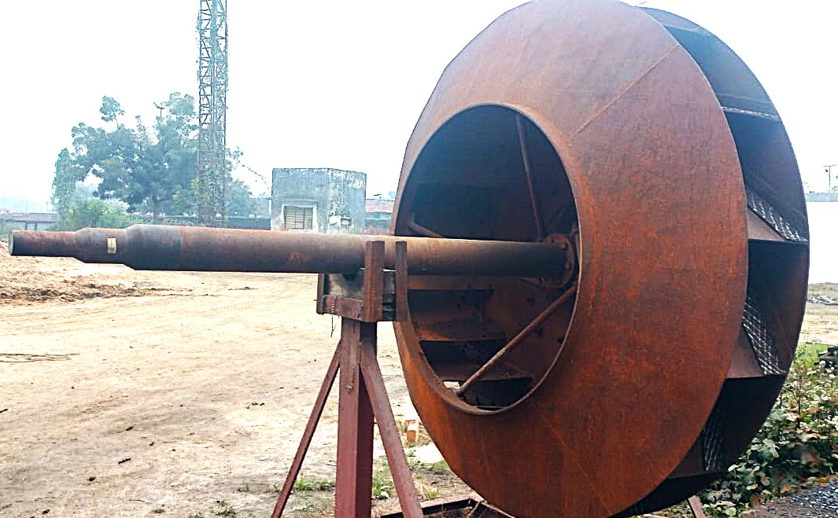
70 TPH BOILER- SPARE ID FAN IMPELLER
BOTH ID FAN SPARE IMPELLER HARD FACING COMPLETED BY USING ELECTRODE N6006

Slide 77
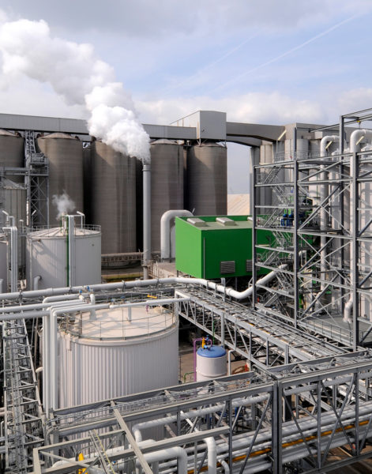
DISTILLERY UNIT

Slide 78
Weekly Performance Snapshot - Distillery
S.N | Capacity Utilization | Target | Current Week | Last Week | Till Date
1 | Total Production (Lakh Liters) | 8.40 | 8.42 | 8.33 | 76.94
4 | Downtime (Hrs.) |  | 0 | 0 | 502.82
5 | Average Ethanol Prodn./Day (Lakh Liters) | 1.20 | 1.20 | 1.19 | 1.14
 | Efficiency
6 | Ethanol Recovery – Syrup (BL/Qtl Cane) | 7.60 | 7.05 | 7.24 | 6.89
7 | Ethanol Recovery – BH (BL/Qtl) | 31.5 | - | - | 28.17
8 | Ethanol Recovery – Syrup (BL/Qtl) | - | 29.74 | 30.13 | 30.25
7 | Fermentation Efficiency (%) | 91.5 | 91.17 | 91.06 | 90.90
9 | Distillation Efficiency (%) | 98.5 | 98.63 | 98.63 | 98.64
10 | Steam consumed (Kg/BL) | 4.1 | 3.96 | 4.02 | 4.11
11 | Power consumed (KWH/BL) | 0.528 | 0.429 | 0.434 | 0.432
 | Feedstock Quality
11 | Feed Stock | B-Heavy | Syrup | Syrup | Syrup/B-heavy
12 | Total Reducing Sugar % |  | 51.95 | 52.75 | 53.43
13 | Fermentable Sugar % |  | 51.26 | 51.99 | 51.90
14 | UFS % |  | 0.69 | 0.76 | 1.53
78

Slide 79
Last 03 Months Performance Snapshot - Distillery
S.N | Capacity Utilization | Dec.-2025 | Nov.-2025 | Dec-2024
1 | Total Production (Lakh Liters) | 31.54 | 35.80 | 38.96
4 | Downtime (Hrs.) | 7.67 | 2.58 | 0
5 | Average Ethanol Prodn./Day (Lakh Liters) | 1.18 | 1.19 | 1.26
 | Efficiency
6 | Ethanol Recovery – Syrup (BL/Qtl Cane) | 7.21 | 6.68 | 7.56
7 | Ethanol Recovery – BH (BL/Qtl) | - | - | -
8 | Ethanol Recovery – Syrup (BL/Qtl) | 30.12 | 30.33 | 32.12
7 | Fermentation Efficiency (%) | 90.93 | 90.93 | 92.81
9 | Distillation Efficiency (%) | 98.62 | 98.64 | 98.75
10 | Steam consumed (Kg/BL) | 4.13 | 4.07 | 3.66
11 | Power consumed (KWH/BL) | 0.441 | 0.447 | 0.402
 | Feedstock Quality
11 | Feed Stock | Syrup | Syrup | Syrup
12 | Total Reducing Sugar % | 52.84 | 54.06 | 55.16
13 | Fermentable Sugar % | 52.05 | 52.40 | 54.31
14 | UFS % | 0.79 | 1.66 | 0.85
79

Slide 80
Key Operational Parameters
Particulars | Current Week | Last Week | Last year Week | Till Date
 | SS 25-26 | SS 25-26 | SS 24-25 | SS 25-26 | SS 24-25
Feed Stock | Syrup | Syrup | Syrup | Syrup | Syrup
Average Ethanol Prodn. / Day | 120245.0 | 119014.0 | 125671.0 | 119196.0 | 124700
Capacity Utilization | 96.20 | 95.21 | 100.54 | 95.36 | 99.76
Ethanol Prodn. ( In BL) | 841716.60 | 833100 | 879700 | 6920539.40 | 7284953.50

Slide 81
Key Operational Parameters
Particulars | Weekly |  | Till Date
 | SS 25-26 | SS 24-25 | SS 25-26 | SS 24-25
Feed Stock | Syrup | Syrup | Syrup | Syrup
B-heavy/Syrup molasses Utilized(In Qtl) | 28300.0 | 27475.0 | 228750.0 | 226700
Ethanol Prod. BL / Qtl | 29.74 | 32.02 | 30.25 | 32.13
Total Reducing Sugar % | 51.95 | 55.29 | 53.54 | 55.14
Fermentable Sugar % | 51.26 | 54.15 | 52.27 | 54.42
UFS % | 0.69 | 1.14 | 1.27 | 0.72
Distillation Efficiency | 98.63 | 98.75 | 98.63 | 98.81
Fermentation Efficiency | 91.17 | 92.80 | 90.93 | 92.62

Slide 82
Key Operational Parameters
Sugar Season | 2025-26
Particulars | Budgeted (Week) | Achieved (Week) | Budgeted (To date) | Achieved (To date)
Feed Stock | Syrup |  | Syrup/B-heavy
Ethanol Prodn. ( In BL) | 840000 | 841716.60 | 7320000 | 7693907.0
Steam consumed in (MT) | 3444.0 | 3329.80 | 40601.40 | 31593.6
Steam consumed Kg/BL | 4.10 | 4.02 | 4.10 | 4.11
Power consumed in (Kwh) | 443520 | 361400 | 5068800 | 3323923
Power consumed Kwh/BL | 0.528 | 0.434 | 0.528 | 0.432

Slide 83
Analysis of Cane syrup received
Particulars | Current Week |  |  | Last Week
Date | Brix | pH | TRS% | Brix | pH | TRS%
21/12/2025 | 61.18 | 6.20 | 52.57 | 59.80 | 6.20 | 51.51
22/12/2025 | 60.47 | 6.25 | 51.00 | 60.78 | 6.23 | 52.57
23/12/2025 | 60.47 | 6.20 | 50.50 | 60.78 | 6.25 | 52.57
24/12/2025 | 63.03 | 6.19 | 50.50 | 61.80 | 6.25 | 52.85
25/12/2025 | 61.22 | 6.26 | 51.00 | 61.12 | 6.20 | 52.85
26/12/2025 | 60.59 | 6.25 | 51.51 | 61.98 | 6.22 | 53.12
27/12/2025 | 60.19 | 6.22 | 51.51 | 60.53 | 6.21 | 53.12
Average | 61.02 | 6.22 | 51.22 | 60.82 | 6.22 | 52.62

Slide 84
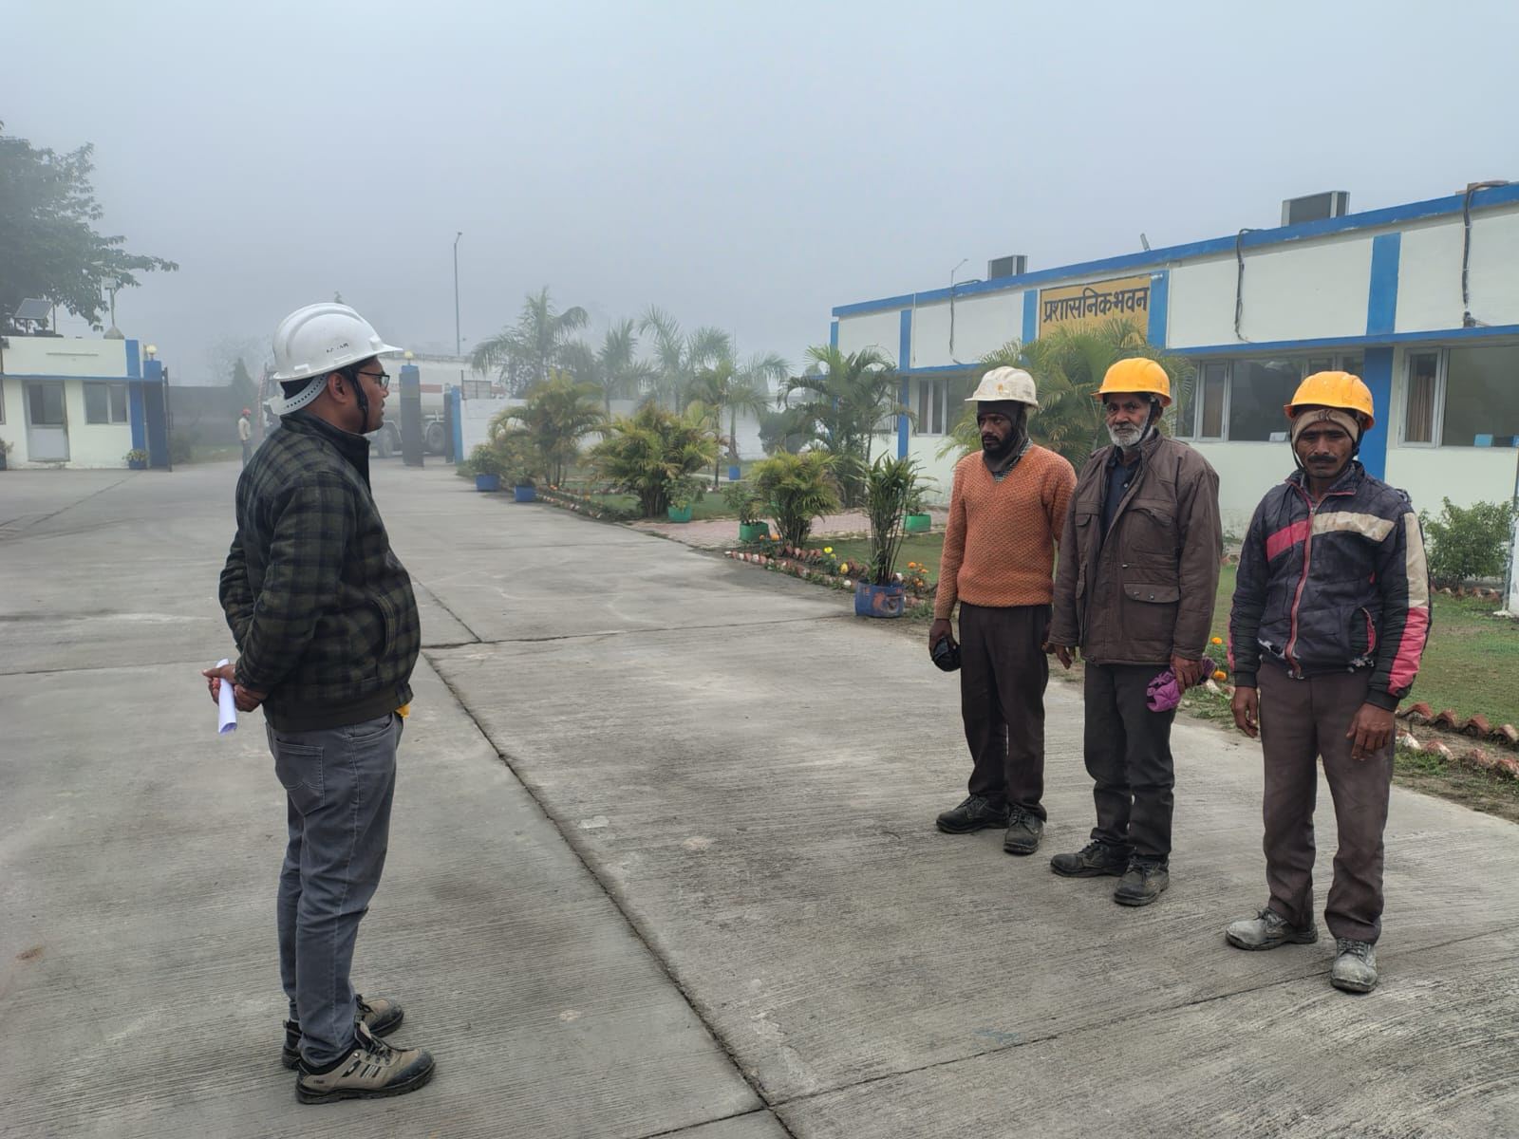
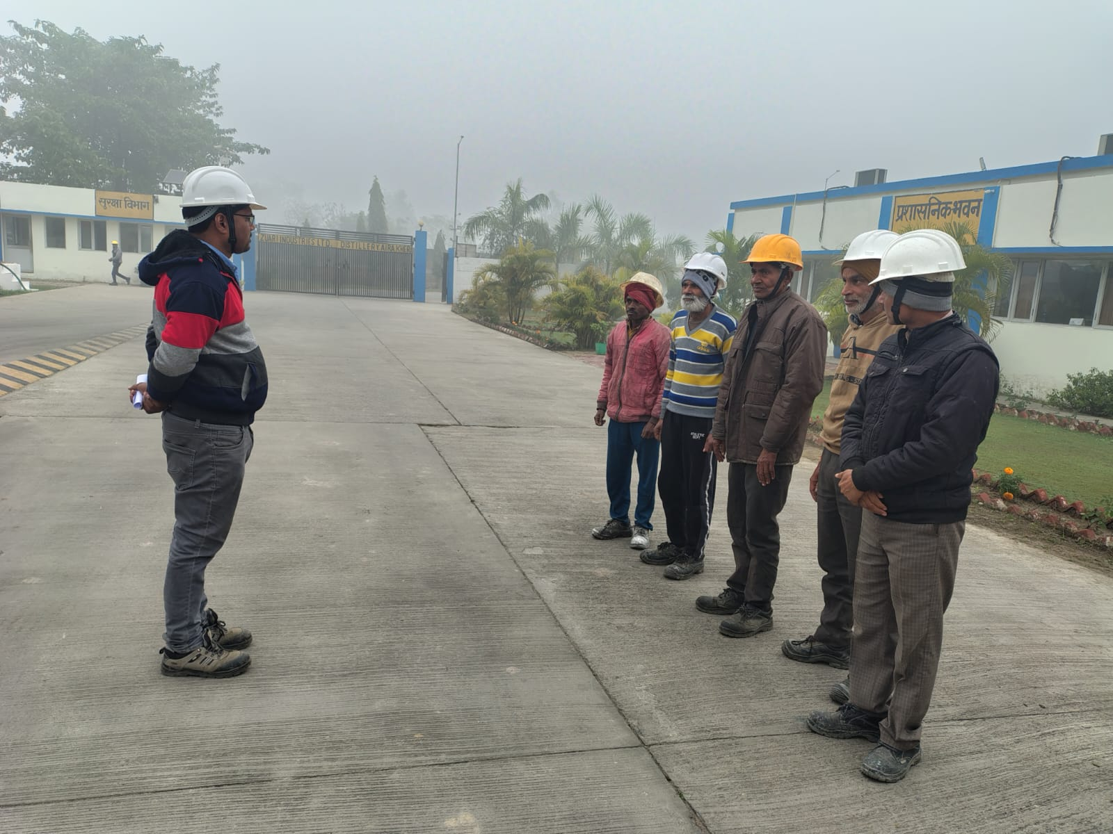
TBT

Slide 85
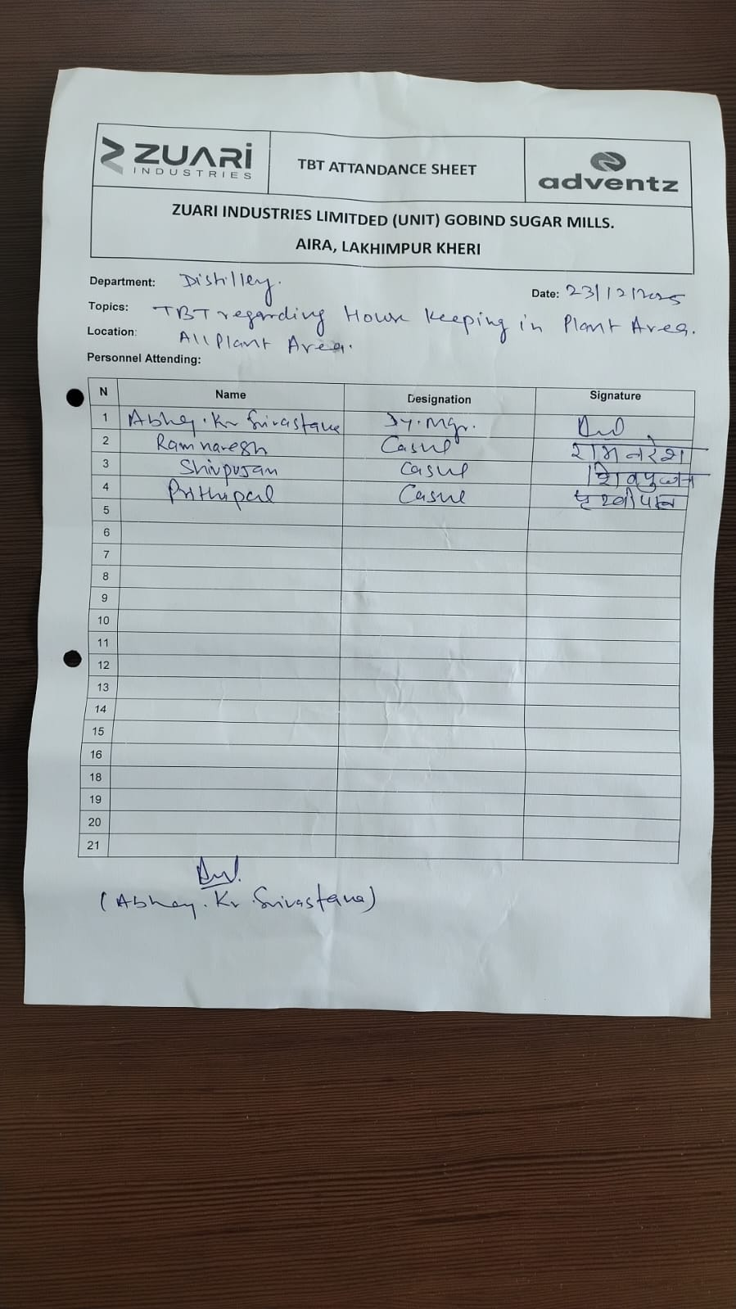
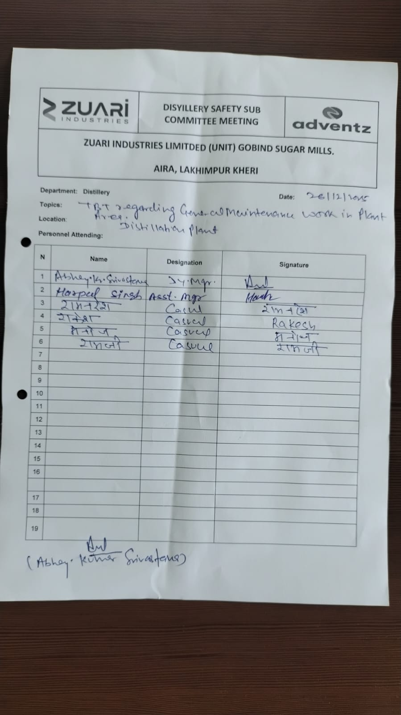
TBT Attendance

Slide 86
Near Miss or Hazardous Activity Report
HAZARDS OBSERVATION - DISTILLERY
S.N | DATE | HAZARDOUS ACTIVITY/ OBSERVATION | LOCATION | ACTION REQUIRED/ TAKEN | TARGET DATE | RESPONSIBILITY | STATUS
1. | 21/12/2025 | 2 Litre flask broken to fermentation operator during keeping in autoclave for sterilization. | Laboratory | Instruct to operator keep flask very carefully in autoclave & right sequence. | Immediate | Mr. Harpal Singh | Completed
2. | 23/12/2025 | Fermentation working floor steam line joint leakage. | Fermentation | Joint sheet changed with new joint sheet. | Immediate | Mr. Avhay Kumar | Completed
3. | 24/12/2025 | Fermenter No-04 coupling spider broken. | Fermentation House | New spider fitted. | Immediate | Mr.Ram pravesh | Completed
4. | 26/12/2025 | MSDH Plant Evaporator column bottom main hole leakage. | Distillation Plant | Gasket has been changed with new gasket immediately. | Immediate | Mr. Brij Mohan Shukla | Completed

Slide 87
Near Miss or Hazardous Activity Report
NEARMISS - DISTILLERY
S.N | DATE | HAZARDOUS ACTIVITY / OBSERVATION | LOCATION | ACTION REQUIRED / TAKEN | TARGET DATE | RESPONSIBILITY | STATUS
1 | 21/12/2025 | Lab chemist using Hazardous chemicals without wearing gloves & goggles .No injury occurred.. | Lab | Instruct to chemist always using proper PPE,S while using the hazardous chemicals | Immediate | Mr.Sarang singhal | Completed
2 | 23/12/2025 | Spanner slipped during opening of falling film body-05 .No injury occurred | MEE Plant | Instruct to fitter very carefully doing the maintenance jobs. | Immediate | Mr. Brijmohan shukla | Completed
3 | 25/12/2025 | Fermenter no-4 having abnormal sound during operation . No injury occurred. | Fermentation Section | Attend by fitter without any delay. | Immediate | Mr. Shubham Patel | Completed
4 | 26/12/2025 | MSDH Plant Evaporator column bottom main hole leakage. No injury occurred. | Distillation Plant | Gasket has been changed with new gasket immediately. | Immediate | Mr. Brij Mohan Shukla | Completed

Slide 88

IT

Slide 89
Executive Summary
- Point 1: Successfully completed data migration in preparation for the upcoming crushing season.
- Point 2: Effectively configured systems for sugarcane procurement at both gate and collection centers, enhancing process efficiency and transparency.
- Point 3: Achieved successful go-live with integration testing between SAP and the Cane Management System (CMS), streamlining procurement, payment processing, and stakeholder data management.
- Point 4: Upgraded network infrastructure by replacing legacy switches with advanced HP Aruba switches, improving connectivity and performance.
Point 5: Initiated routine operational activities for the crushing season, aligning teams and resources for smooth execution.
Point 6: Installation of an NPR camera at the new molasses loading point.
Point 7: OPS server upgradation.
89

Slide 90
General Observation
S. No. | Description
1 | Active Saksham App Growers: Installed – 39,034 / Active – 20,415
2 | GPS Installed in Center Trucks: 298
3 | Weighbridges (Gate + Centers): Total – 107, Active – 107
4 | Truck Received & Total Weight: 15665 NOS Trucks / 3947954 QTLS
5 | This Week Truck Received & Weight: 1747 NOS Trucks / 462951 QTLS
6 | Total Purchase (Grower & Purchi): Grower – 49137 NOS , Purchi 149411– NOS Weight 6329295- QTLS
7 | This Week Purchase (Grower & Purchi): Grower – 12601 NOS, Purchi – 16276 NOS ,Weight - 740317 QTLS

Slide 91

QUALITY CONTROL

Slide 92
Summary For Season 25-26

Slide 93
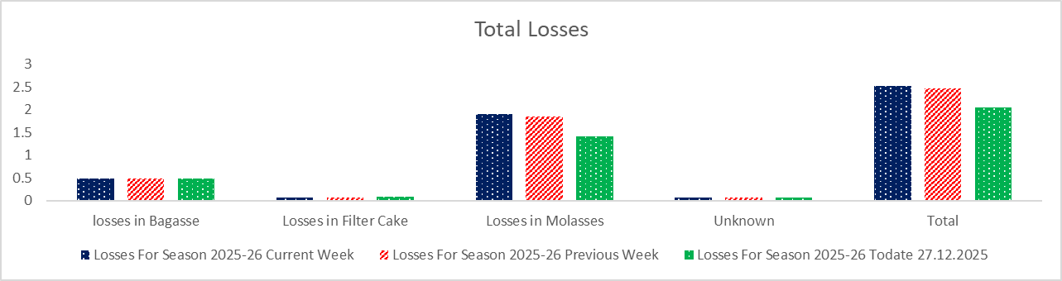
TOTAL LOSSES

Slide 94
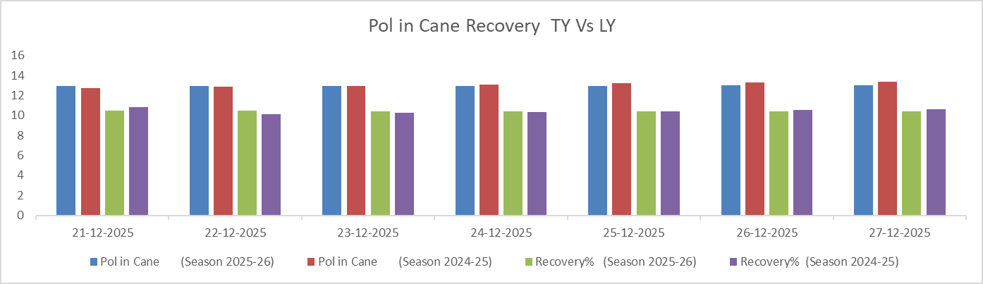
Pol in Cane Comparison

Slide 95
Certification Status
Sr. No. | Certification | Implementation | Validity | Next Audit | Remark
1 | FSSC: 22000:2018 | MAY-2019 | MAY-28 | FEB-26 | Next surveillance audit due in Feb-26
2 | ISO: 9001:2015 | OCT-2011 | OCT-26 | OCT-27 | Next due in Oct-2025
3 | EnMS, ISO: 50001:2018 | JAN-26 (Tentative) | - | - | Documentation in process and Gap assessment audit scheduled plan in NOV-25
4 | KOSHER | 30 OCT-25 | 29 OCT-26 | SEP-26- | Included with Speciality Sugar
5 | IMS (ISO: 9001, ISO:14001 & ISO 45001:2018 | APR-26 (Tentative) | - | - | Implementation process starts at our hand and documentation part in process
6 | IP License | SEP-22 | SEP-27 | SEP-27 | BP Sucrose include during SS 2024-25 and plan to include USP Sucrose during SS 2025-26

Slide 96
KPI Target Vs Achieved

Slide 97
Cane Crushed Data Capacity Wise

Slide 98


EHS
Dec-2025

Slide 99
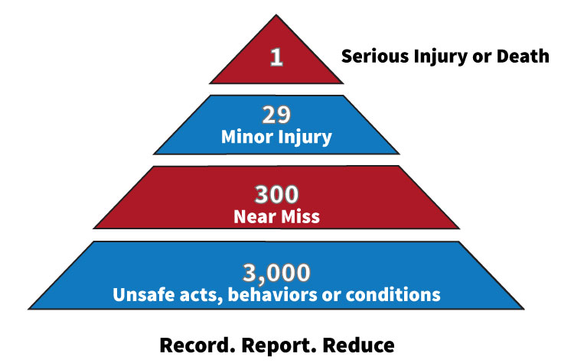
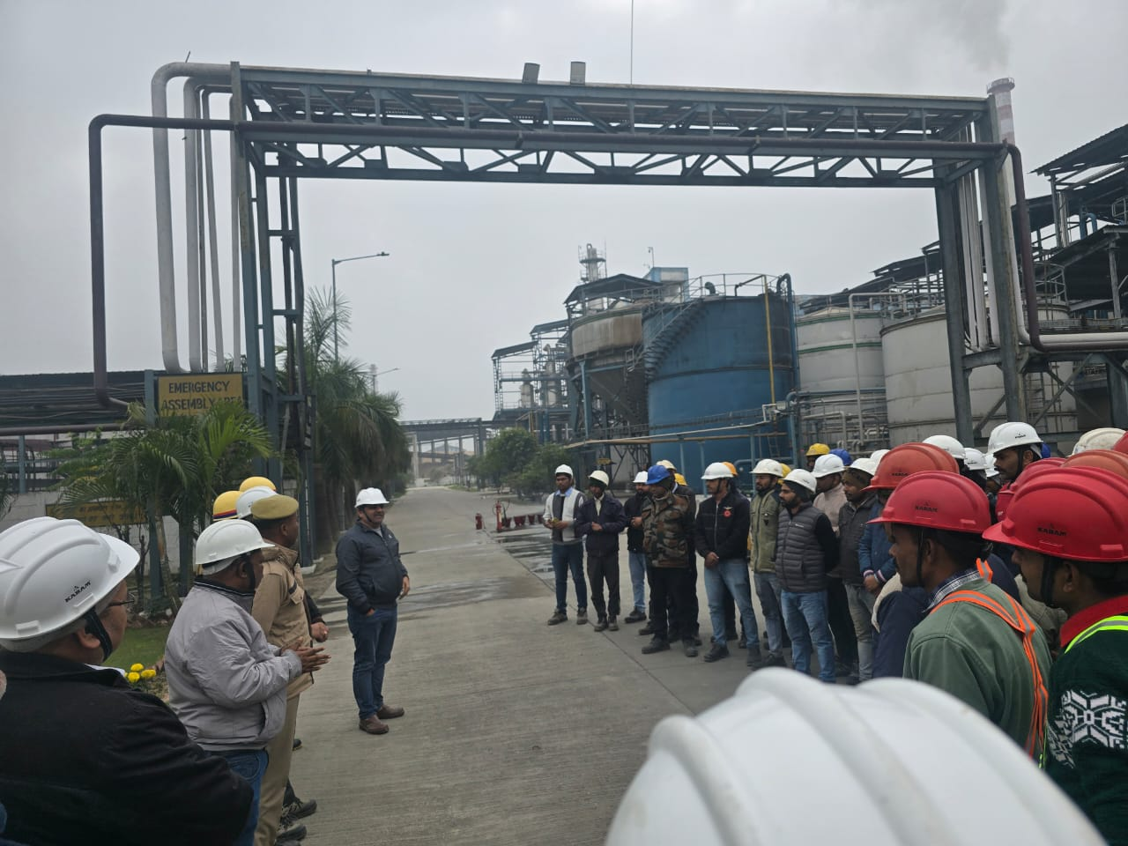
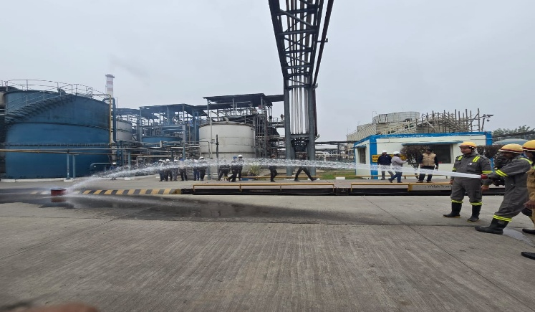
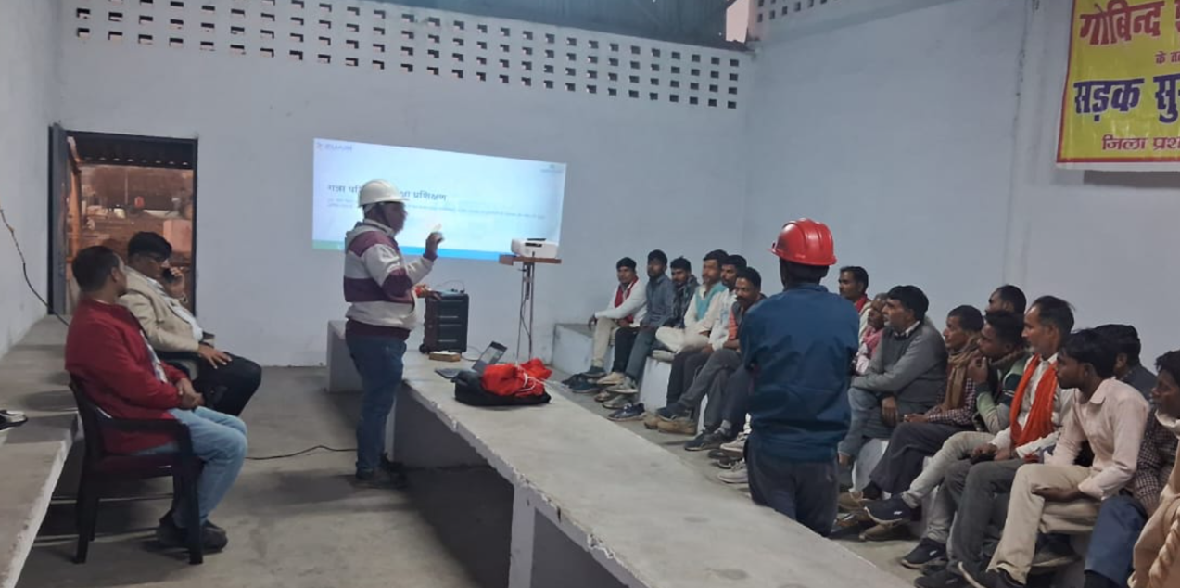
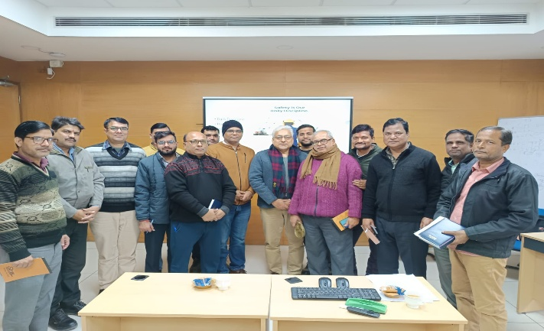
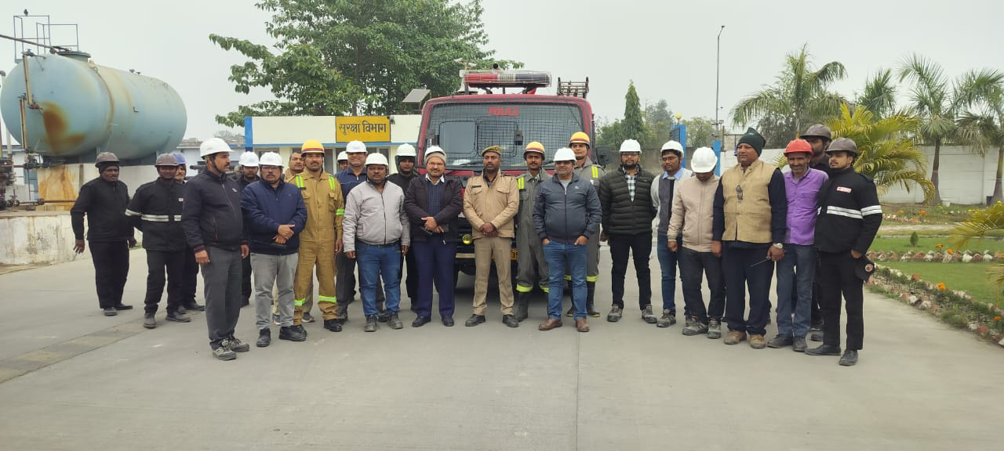
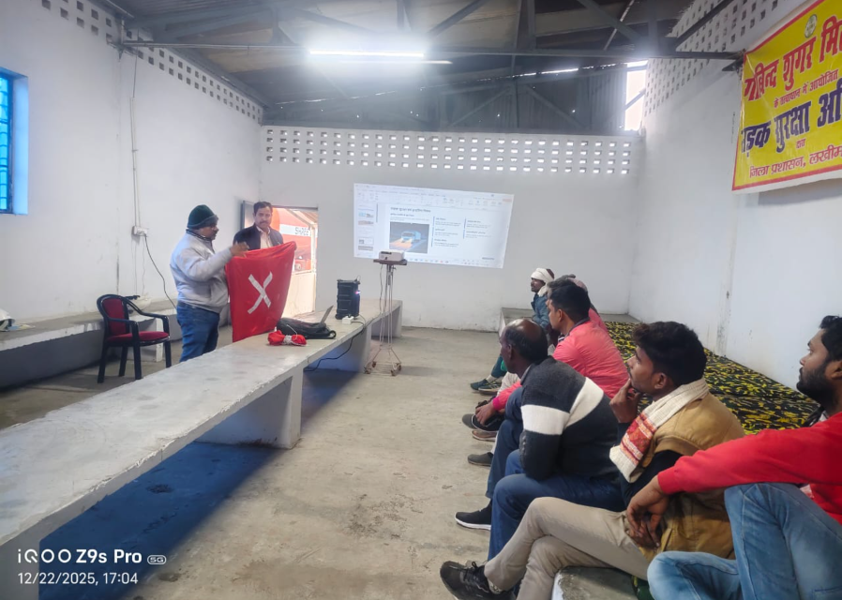
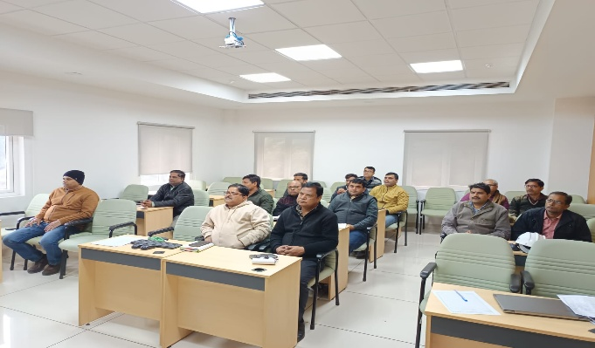
EHS
Sr No | Incident | 2nd Week Dec-25
1 | Near Miss | 0
2 | First Aid | 0
3 | Minor | 0
4 | Major/Fatality | 0
5 | Fire Incident | 0
6 | Unsafe Act/ Unsafe Condition/unsafe behaviour | 7
7 | Training conducted Total Participants | 28 135
Water Consumption & Extraction
New Initiatives
.Training started at cane office for truck/ tractor drivers & formers.
Implementation of reflection/radium tapes ( Paint/tapes).at both the roadside trees and pols for proper marking and clearance of way. For cane vehicles in foggy season)
3. Fire mock drill conducted in Distillery Unit with joint adventure of UP fire station (Dhaurahra) team to insure the emergency preparedness.
4. Four session of BBS Training conduct in this week.
.
Fire Mock Drill at Distillery
Road Safety & BBS Training

Slide 100
Bore Well Water Details

Slide 101
Effluent Flow & Parameters

Slide 102


Thank You!

